Slide 1
COEN 243: Programming Methodology I Lecture 1: Introduction to Programming

Slide 2
1.1 Introduction
C++—a powerful computer programming language that’s appropriate for technically oriented people with little or no programming experience, and for experienced programmers to use in building substantial information systems.
You’ll write instructions commanding computers to perform those kinds of tasks.
Software (i.e., the instructions you write) controls hardware (i.e., computers).
You’ll learn object-oriented programming—today’s key programming methodology.
You’ll create many software objects in the real world.

Slide 3
1.1 Introduction (Cont.)
C++ is one of today’s most popular software development languages.
This text provides an introduction to programming in C++11—the latest version standardized through the International Organization for Standardization (ISO) and the International Electrotechnical Commission (IEC).
In use today are more than a billion general-purpose computers and billions more cell phones, smartphones and handheld devices (such as tablet computers).

Slide 4
1.1 Introduction (Cont.)
The number of mobile Internet users will reach approximately 134 million by 2013. (www.circleid.com/posts/mobile_internet_users_to_reach_134_million_by_2013/)
Smartphone sales surpassed personal computer sales in 2011. (www.mashable.com/2012/02/03/smartphone-sales-overtake-pcs/)
Tablet sales are expected to account for over 20% of all personal computer sales by 2015. (www.forrester.com/ER/Press/Release/0,1769,1340,00.html)
By 2014, the smartphone app market is expected to exceed $40 billion. (Inc., December 2010/January 2011, pages 116–123)
This explosive growth is creating significant opportunities for programming mobile apps.

Slide 5
1.2 Computers and the Internet in Industry and Research
Many of the most influential and successful businesses of the last two decades are technology companies, including Apple, IBM, Hewlett Packard, Dell, Intel, Motorola, Cisco, Microsoft, Google, Amazon, Facebook, Twitter, Groupon, Foursquare, Yahoo!, eBay and many more.
These companies are major employers of people who study computer science, computer engineering, information systems or related disciplines.

Slide 6
1.3 Hardware and Software
Computers can perform calculations and make logical decisions phenomenally faster than human beings can.
Today’s personal computers can perform billions of calculations in one second—more than a human can perform in a lifetime.
Supercomputers are already performing thousands of trillions (quadrillions) of instructions per second!
Computers process data under the control of sequences of instructions called computer programs.
These programs guide the computer through ordered actions specified by people called computer programmers.

Slide 7
1.3 Hardware and Software (Cont.)
The programs that run on a computer are referred to as software.
You’ll learn a key programming methodology that’s enhancing programmer productivity, thereby reducing software-development costs—object-oriented programming.
A computer consists of various devices referred to as hardware
(e.g., the keyboard, screen, mouse, hard disks, memory, DVD drives and processing units).
Computing costs are dropping dramatically, owing to rapid developments in hardware and software technologies.

Slide 8
1.3 Hardware and Software (Cont.)
Computers that might have filled large rooms and cost millions of dollars decades ago are now inscribed on silicon chips smaller than a fingernail, costing perhaps a few dollars each.
Silicon-chip technology has made computing so economical that computers have become commodity.

Slide 9
1.3.1 Moore’s Law
For many decades, hardware costs have fallen rapidly.
Every year or two, the capacities of computers have approximately doubled inexpensively.
This trend often is called Moore’s Law, named for the person who identified it in the 1960s, Gordon Moore, co-founder of Intel.

Slide 10
1.3.1 Moore’s Law (Cont.)
Moore’s Law and related observations apply especially to the amount of memory that computers have for programs, the amount of secondary storage (such as disk storage) they have to hold programs and data over longer periods of time, and their processor speeds—the speeds at which computers execute their programs (i.e., do their work).
Similar growth has occurred in the communications field.

Slide 11
1.3.1 Moore’s Law (Cont.)
Costs have plummeted as enormous demand for communications bandwidth (i.e., information-carrying capacity) has attracted intense competition.
Such phenomenal improvement is fostering the Information Revolution.

Slide 12
1.3.2 Computer Organization
Regardless of differences in physical appearance, computers can be envisioned as divided into various logical units or sections (Fig. 1.2)

Slide 13
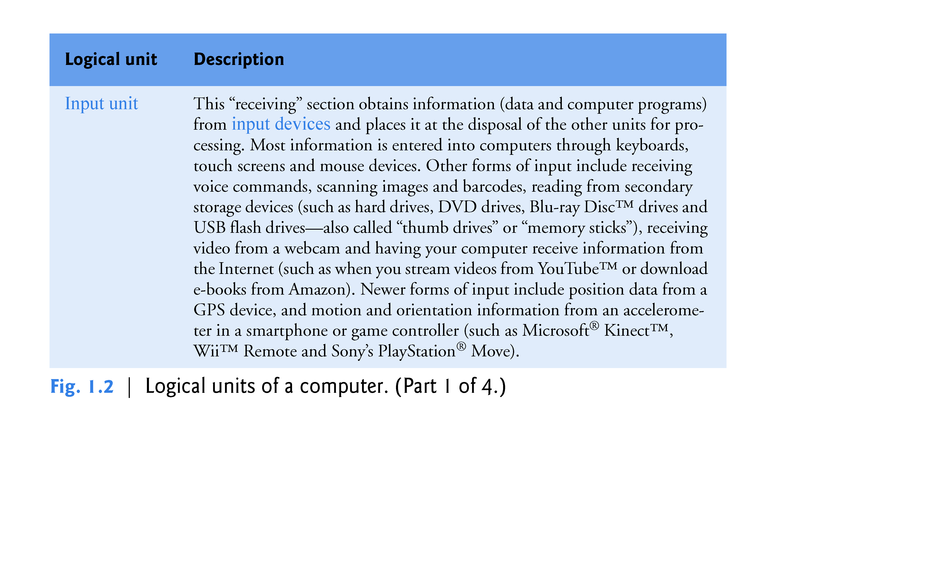

Slide 14
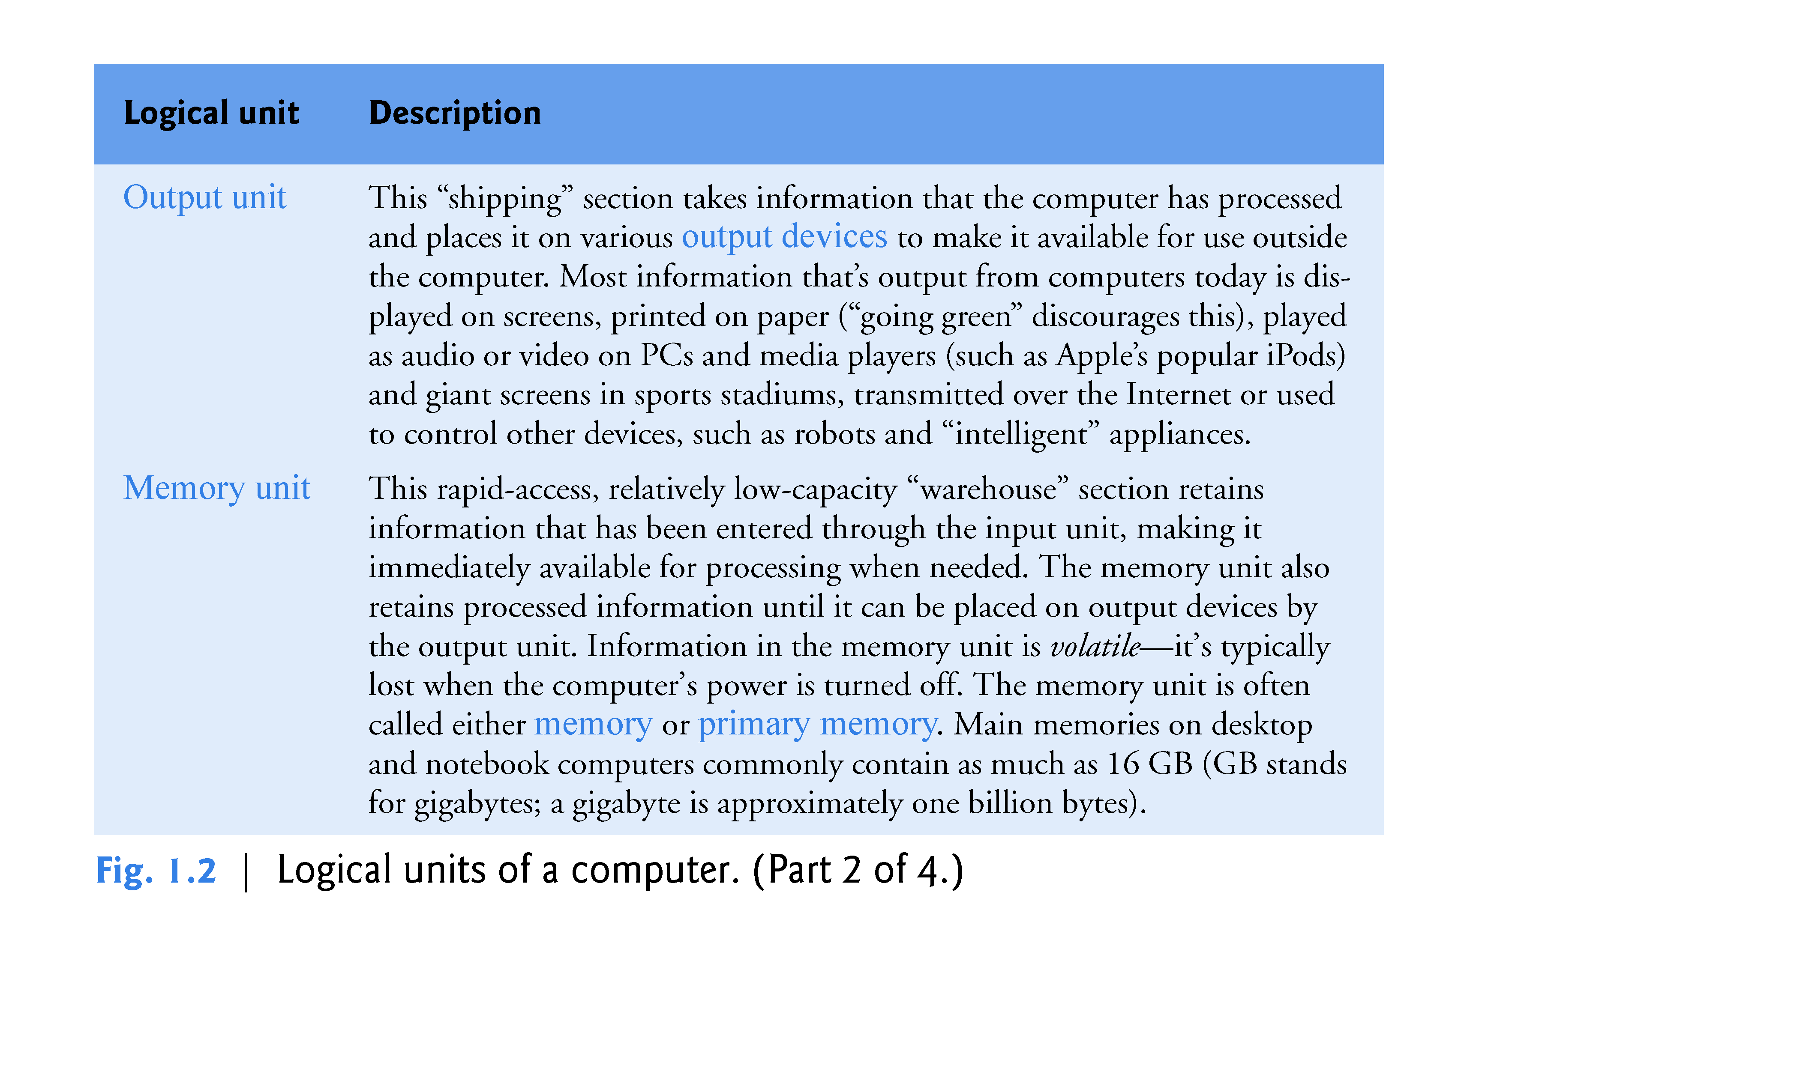

Slide 15
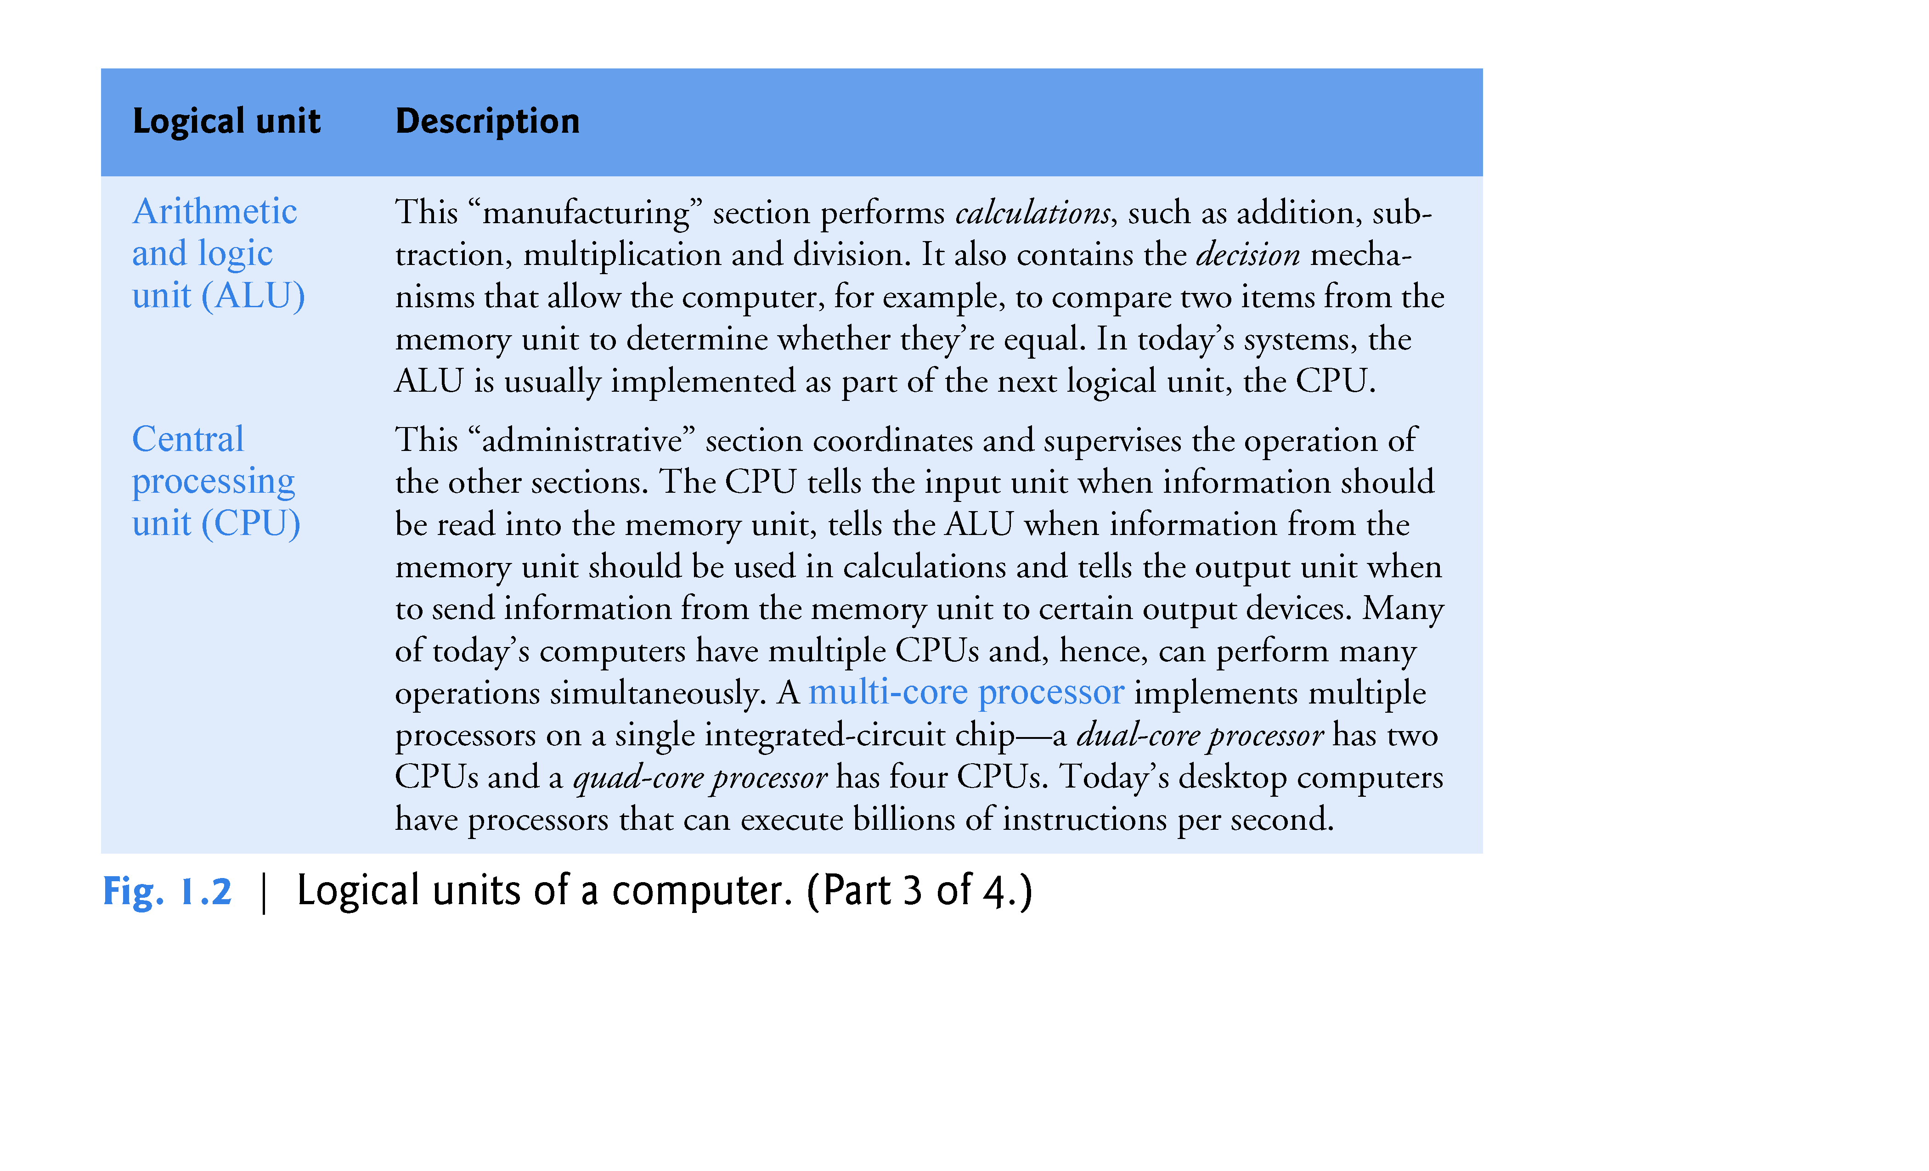

Slide 16
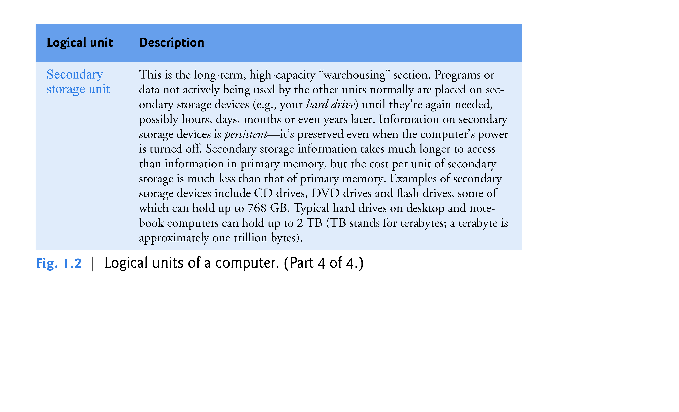

Slide 17
1.4 Data Hierarchy
Data items processed by computers form a data hierarchy that becomes larger and more complex in structure as we progress from bits to characters to fields, and so on.

Slide 18
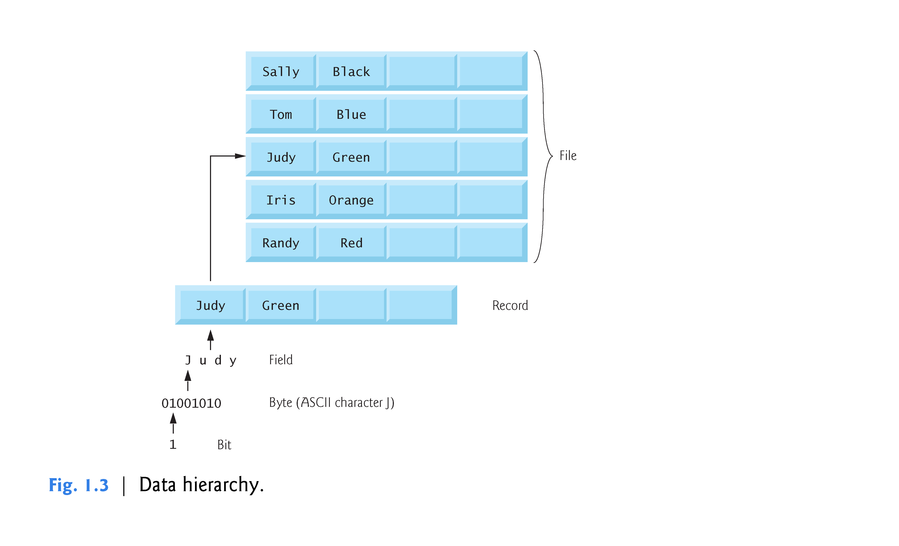

Slide 19
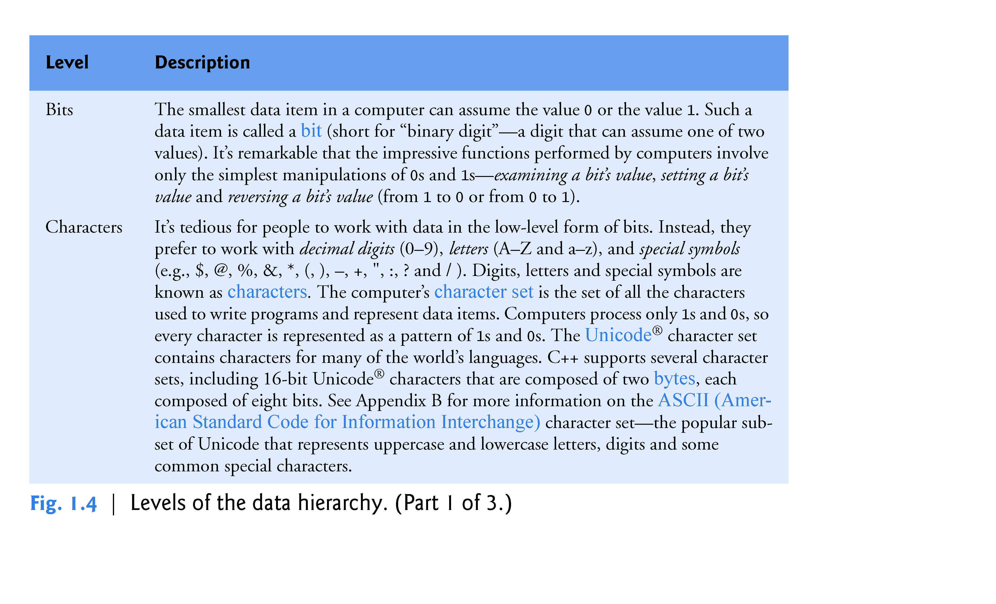

Slide 20
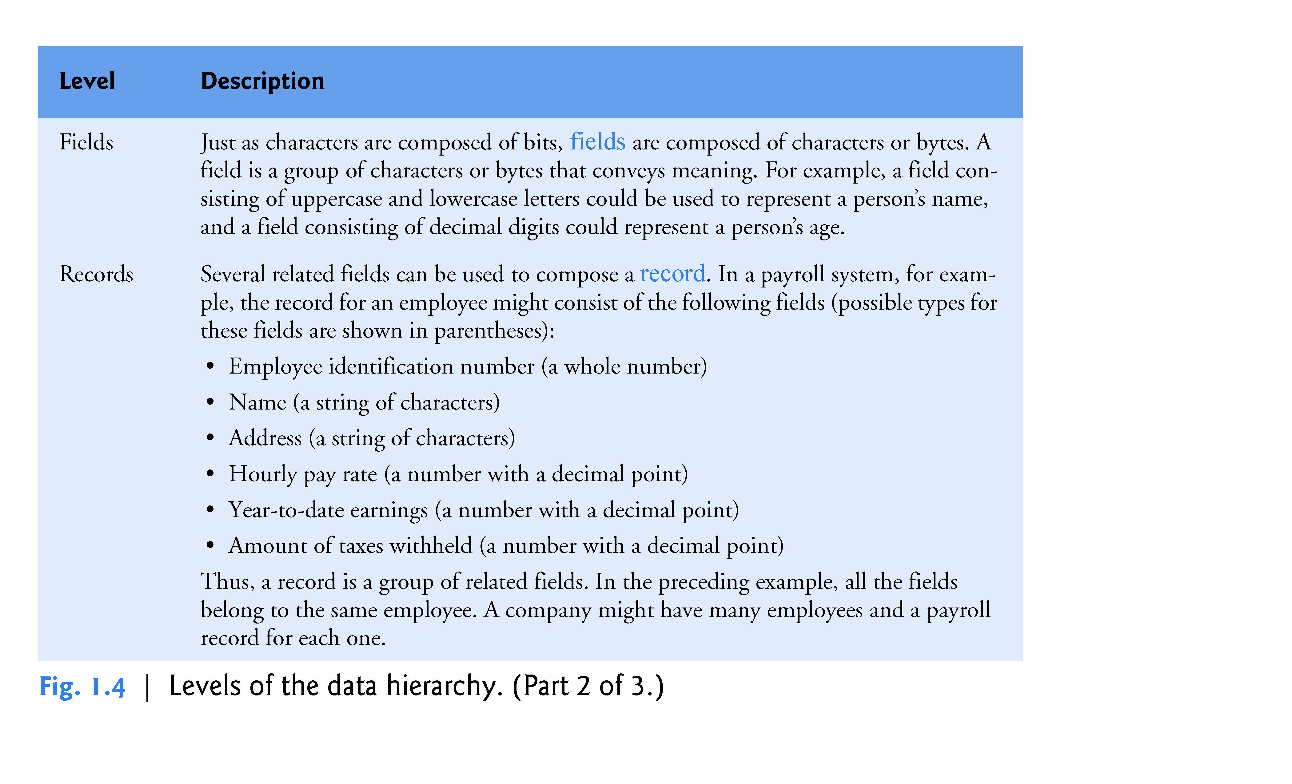

Slide 21
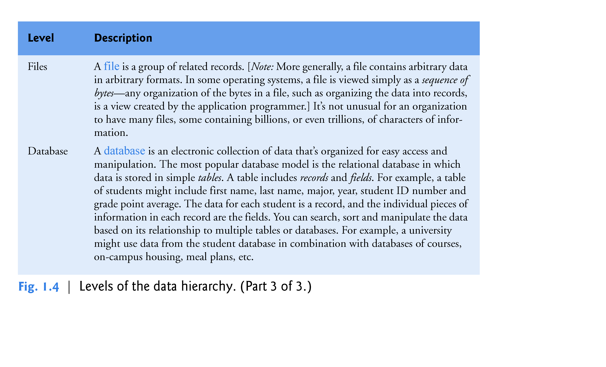

Slide 22
1.5 Machine Languages, Assembly Languages and High-Level Languages
Programmers write instructions in various programming languages, some directly understandable by computers and others requiring intermediate translation steps.
These may be divided into three general types:
Machine languages
Assembly languages
High-level languages

Slide 23
1.5 Machine Languages, Assembly Languages and High-Level Languages (Cont.)
Machine Languages
Any computer can directly understand only its own machine language (also called machine code), defined by its hardware architecture.
Machine languages generally consist of numbers (ultimately reduced to 1s and 0s). Such languages are cumbersome for humans.

Slide 24
1.5 Machine Languages, Assembly Languages and High-Level Languages (Cont.)
Assembly Languages
English-like abbreviations to represent elementary operations. These abbreviations formed the basis of assembly languages.
Translator programs called assemblers were developed to convert early assembly-language programs to machine language.

Slide 25
1.5 Machine Languages, Assembly Languages and High-Level Languages (Cont.)
High-Level Languages
To speed up the programming process further, high-level languages were developed in which single statements could be written to accomplish substantial tasks.
Translator programs called compilers convert high-level language programs into machine language.
Allow you to write instructions that look more like everyday English and contain commonly used mathematical expressions.

Slide 26
1.5 Machine Languages, Assembly Languages and High-Level Languages (Cont.)
Compiling a high-level language program into machine language can take a considerable amount of computer time.
Interpreter programs were developed to execute high-level language programs directly (without the need for compilation), although more slowly than compiled programs.
Scripting languages such as the popular web languages JavaScript and PHP are processed by interpreters.

Slide 27
1.6 C++
C++ evolved from C, which was developed by Dennis Ritchie at Bell Laboratories.
C
Available for most computers and is hardware independent.
It’s possible to write C programs that are portable to most computers.
The widespread use of C with various kinds of computers (sometimes called hardware platforms) led to many variations.
American National Standards Institute (ANSI) cooperated with the International Organization for Standardization (ISO) to standardize C worldwide.
Joint standard document was published in 1990 and is referred to as ANSI/ISO 9899: 1990.

Slide 28
1.6 C++ (Cont.)
C11
Latest ANSI standard for the language.
Developed to evolve the C language to keep pace with increasingly powerful hardware and ever more demanding user requirements.
Makes C more consistent with C++.
C++, an extension of C, was developed by Bjarne Stroustrup in 1979 at Bell Laboratories.
C++ provides a number of features that “spruce up” the C language, but more importantly, it provides capabilities for object-oriented programming.

Slide 29
1.6 C++ (Cont.)
C++ Standard Library
C++ programs consist of pieces called classes and functions.
Most C++ programmers take advantage of the rich collections of classes and functions in the C++ Standard Library.
Two parts to learning the C++ “world.”
The C++ language itself, and
How to use the classes and functions in the C++ Standard Library.
Many special-purpose class libraries are supplied by independent software vendors.

Slide 30
1.8 Introduction to Object Technology
Objects, or more precisely—as we’ll see in Chapter 3—the classes objects come from, are essentially reusable software components.
There are date objects, time objects, audio objects, video objects, automobile objects, people objects, etc.
Almost any noun can be reasonably represented as a software object in terms of attributes (e.g., name, color and size) and behaviors (e.g., calculating, moving and communicating).
Using a modular, object-oriented design-and-implementation approach can make software-development groups much more productive than was possible with earlier techniques—object-oriented programs are often easier to understand, correct and modify.

Slide 31
1.8 Introduction to Object Technology (Cont.)
The Automobile as an Object
Let’s begin with a simple analogy.
Suppose you want to drive a car and make it go faster by pressing its accelerator pedal.
Before you can drive a car, someone has to design it.
A car typically begins as engineering drawings, similar to the blueprints that describe the design of a house.
Drawings include the design for an accelerator pedal.
Pedal hides from the driver the complex mechanisms that actually make the car go faster, just as the brake pedal hides the mechanisms that slow the car, and the steering wheel hides the mechanisms that turn the car.

Slide 32
1.8 Introduction to Object Technology (Cont.)
Enables people with little or no knowledge of how engines, braking and steering mechanisms work to drive a car easily.
Before you can drive a car, it must be built from the engineering drawings that describe it.
A completed car has an actual accelerator pedal to make the car go faster, but even that’s not enough—the car won’t accelerate on its own (hopefully!), so the driver must press the pedal to accelerate the car.

Slide 33
1.8 Introduction to Object Technology (Cont.)
Member Functions and Classes
Performing a task in a program requires a member function
Houses the program statements that actually perform its task.
Hides these statements from its user, just as the accelerator pedal of a car hides from the driver the mechanisms of making the car go faster.

Slide 34
1.8 Introduction to Object Technology (Cont.)
In C++, we create a program unit called a class to house the set of member functions that perform the class’s tasks.
A class is similar in concept to a car’s engineering drawings, which house the design of an accelerator pedal, steering wheel, and so on.

Slide 35
1.8 Introduction to Object Technology (Cont.)
Instantiation
Just as someone has to build a car from its engineering drawings before you can actually drive a car, you must build an object from a class before a program can perform the tasks that the class’s methods define.
An object is then referred to as an instance of its class.

Slide 36
1.8 Introduction to Object Technology (Cont.)
Reuse
Just as a car’s engineering drawings can be reused many times to build many cars, you can reuse a class many times to build many objects.
Reuse of existing classes when building new classes and programs saves time and effort.

Slide 37
1.8 Introduction to Object Technology (Cont.)
Reuse also helps you build more reliable and effective systems, because existing classes and components often have gone through extensive testing, debugging and performance tuning.
Just as the notion of interchangeable parts was crucial to the Industrial Revolution, reusable classes are crucial to the software revolution that has been spurred by object technology.

Slide 38
1.8 Introduction to Object Technology (Cont.)
Messages and Member Function Calls
When you drive a car, pressing its gas pedal sends a message to the car to perform a task—that is, to go faster.
Similarly, you send messages to an object.
Each message is implemented as a member function call that tells a member function of the object to perform its task.

Slide 39
1.8 Introduction to Object Technology (Cont.)
Attributes and Data Members
A car has attributes
Color, its number of doors, the amount of gas in its tank, its current speed and its record of total miles driven (i.e., its odometer reading).
The car’s attributes are represented as part of its design in its engineering diagrams.
Every car maintains its own attributes.
Each car knows how much gas is in its own gas tank, but not how much is in the tanks of other cars.

Slide 40
1.8 Introduction to Object Technology (Cont.)
An object has attributes that it carries along as it’s used in a program.
Specified as part of the object’s class.
A bank account object has a balance attribute that represents the amount of money in the account.
Each bank account object knows the balance in the account it represents, but not the balances of the other accounts in the bank.
Attributes are specified by the class’s data members.

Slide 41
1.8 Introduction to Object Technology (Cont.)
Encapsulation
Classes encapsulate (i.e., wrap) attributes and member functions into objects—an object’s attributes and member functions are intimately related.
Objects may communicate with one another, but they’re normally not allowed to know how other objects are implemented—implementation details are hidden within the objects themselves.
Information hiding is crucial to good software engineering.

Slide 42
1.8 Introduction to Object Technology (Cont.)
Inheritance
A new class of objects can be created quickly and conveniently by inheritance—the new class absorbs the characteristics of an existing class, possibly customizing them and adding unique characteristics of its own.
In our car analogy, an object of class “convertible” certainly is an object of the more general class “automobile,” but more specifically, the roof can be raised or lowered.

Slide 43
1.8 Introduction to Object Technology (Cont.)
Object-Oriented Analysis and Design (OOAD)
How will you create the code (i.e., the program instructions) for your programs?
Follow a detailed analysis process for determining your project’s requirements (i.e., defining what the system is supposed to do)
Develop a design that satisfies them (i.e., deciding how the system should do it).
Carefully review the design (and have your design reviewed by other software professionals) before writing any code.

Slide 44
1.8 Introduction to Object Technology (Cont.)
If this process involves analyzing and designing your system from an object-oriented point of view, it’s called an object-oriented analysis and design (OOAD) process.
Languages like C++ are object oriented.
Object-oriented programming (OOP) allows you to implement an object-oriented design as a working system.

Slide 45
1.9 Typical C++ Development Environment (Cont.)
C++ systems generally consist of three parts: a program development environment, the language and the C++ Standard Library.
C++ programs typically go through six phases: edit, preprocess, compile, link, load and execute.

Slide 46
1.9 Typical C++ Development Environment (Cont.)
Phase 1 consists of editing a file with an editor program, normally known simply as an editor.
Type a C++ program (source code) using the editor.
Make any necessary corrections.
Save the program.
C++ source code filenames often end with the .cpp, .cxx, .cc or .C extensions (note that C is in uppercase) which indicate that a file contains C++ source code.

Slide 47
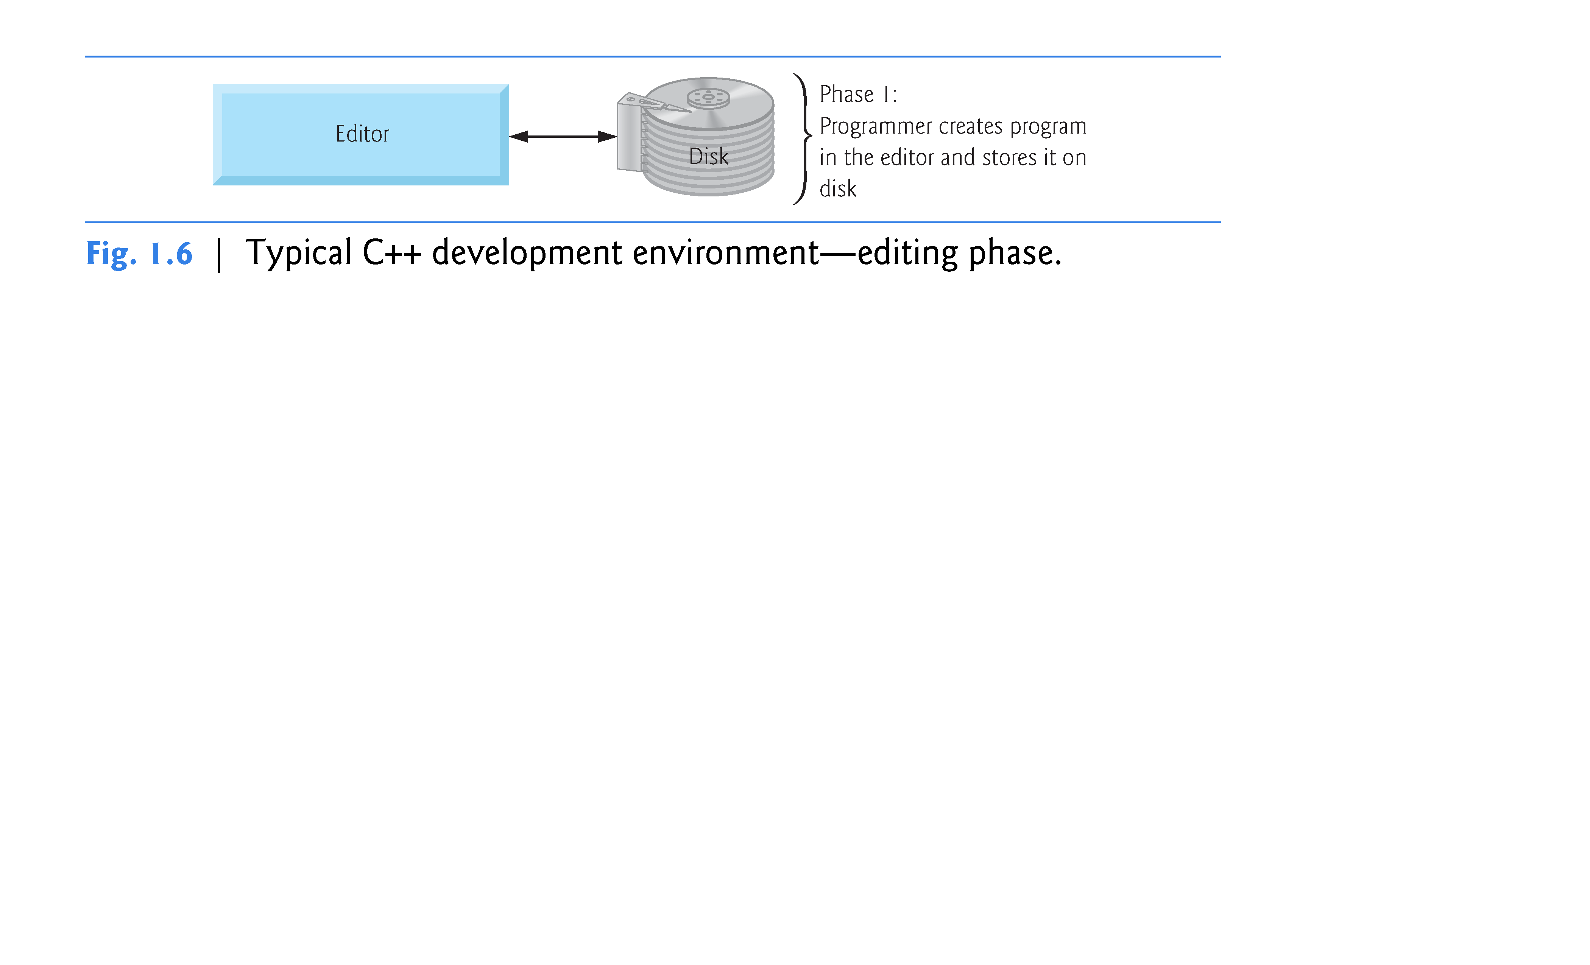

Slide 48
1.9 Typical C++ Development Environment (Cont.)
Linux editors: vi and emacs.
C++ software packages for Microsoft Windows such as Microsoft Visual C++ (microsoft.com/express) have editors integrated into the programming environment.
You can also use a simple text editor, such as Notepad in Windows, to write your C++ code.
integrated development environments (IDEs)
Provide tools that support the software-development process, including editors for writing and editing programs and debuggers for locating logic errors—errors that cause programs to execute incorrectly.

Slide 49
1.9 Typical C++ Development Environment (Cont.)
Popular IDEs
Microsoft® Visual Studio 2012 Express Edition
Dev C++
NetBeans
Eclipse
Apple’s Xcode
CodeLite

Slide 50
1.9 Typical C++ Development Environment (Cont.)
In phase 2, you give the command to compile the program.
A preprocessor program executes automatically before the compiler’s translation phase begins (so we call preprocessing Phase 2 and compiling Phase 3).
The C++ preprocessor obeys commands called preprocessing directives, which indicate that certain manipulations are to be performed on the program before compilation.
These manipulations usually include other text files to be compiled, and perform various text replacements.
The most common preprocessing directives are discussed in the early chapters; a detailed discussion of preprocessor features appears in Appendix E, Preprocessor.

Slide 51
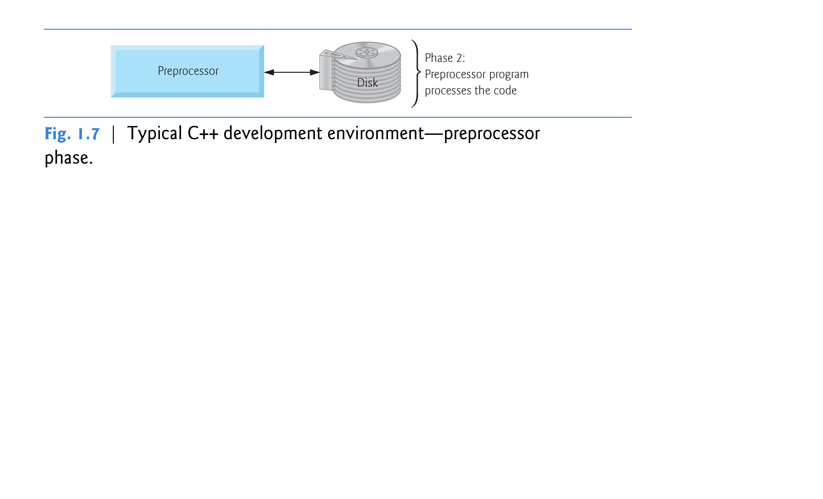

Slide 52
1.9 Typical C++ Development Environment (Cont.)
In Phase 3, the compiler translates the C++ program into machine-language code—also referred to as object code.

Slide 53
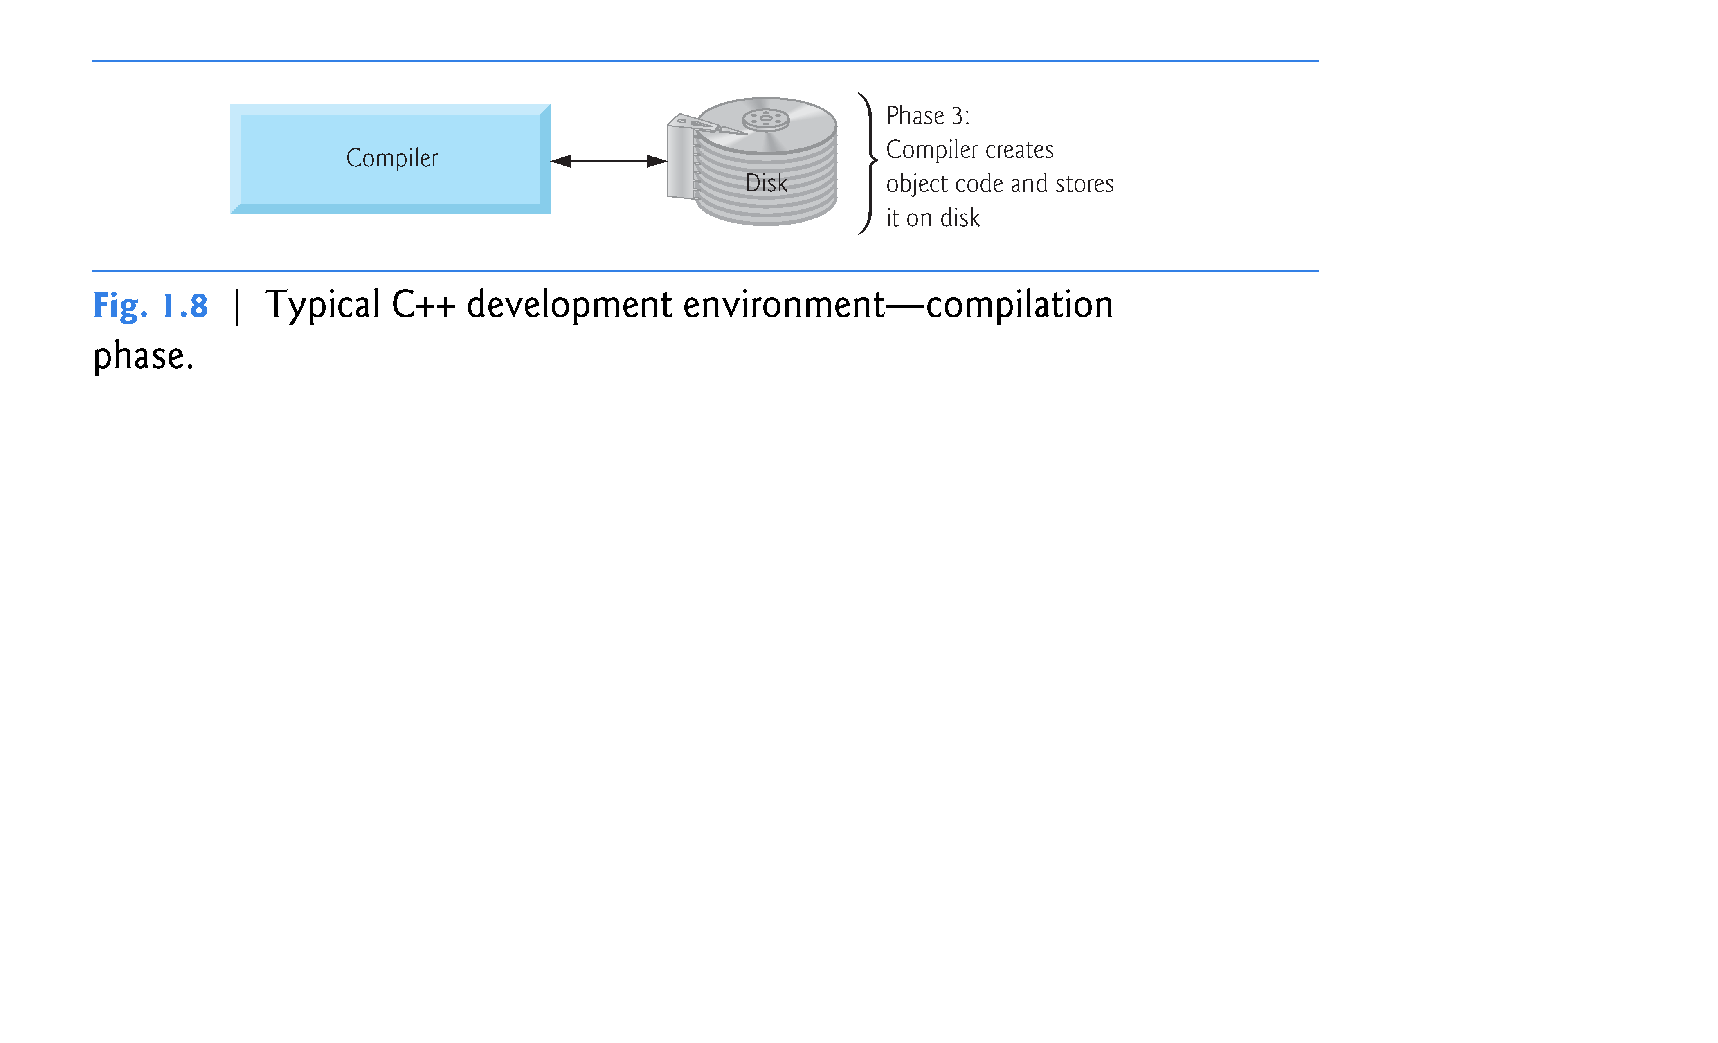

Slide 54
1.9 Typical C++ Development Environment (Cont.)
Phase 4 is called linking.
The object code produced by the C++ compiler typically contains “holes” due to these missing parts.
A linker links the object code with the code for the missing functions to produce an executable program.
If the program compiles and links correctly, an executable image is produced.

Slide 55
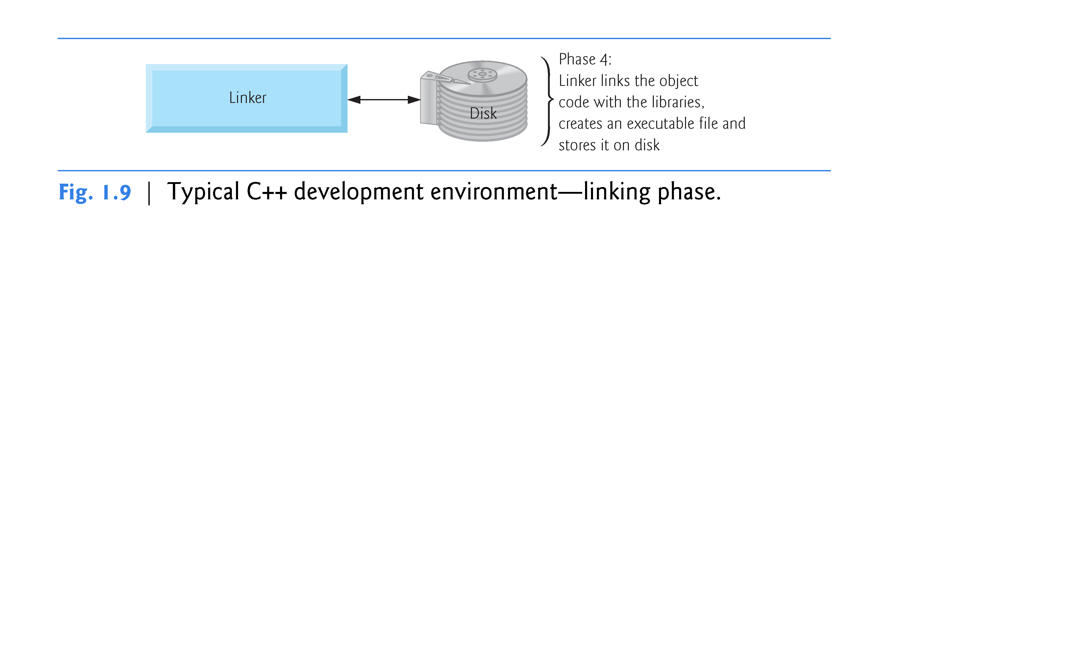

Slide 56
1.9 Typical C++ Development Environment (Cont.)
Phase 5 is called loading.
Before a program can be executed, it must first be placed in memory. T
his is done by the loader, which takes the executable image from disk and transfers it to memory.
Additional components from shared libraries that support the program are also loaded.

Slide 57
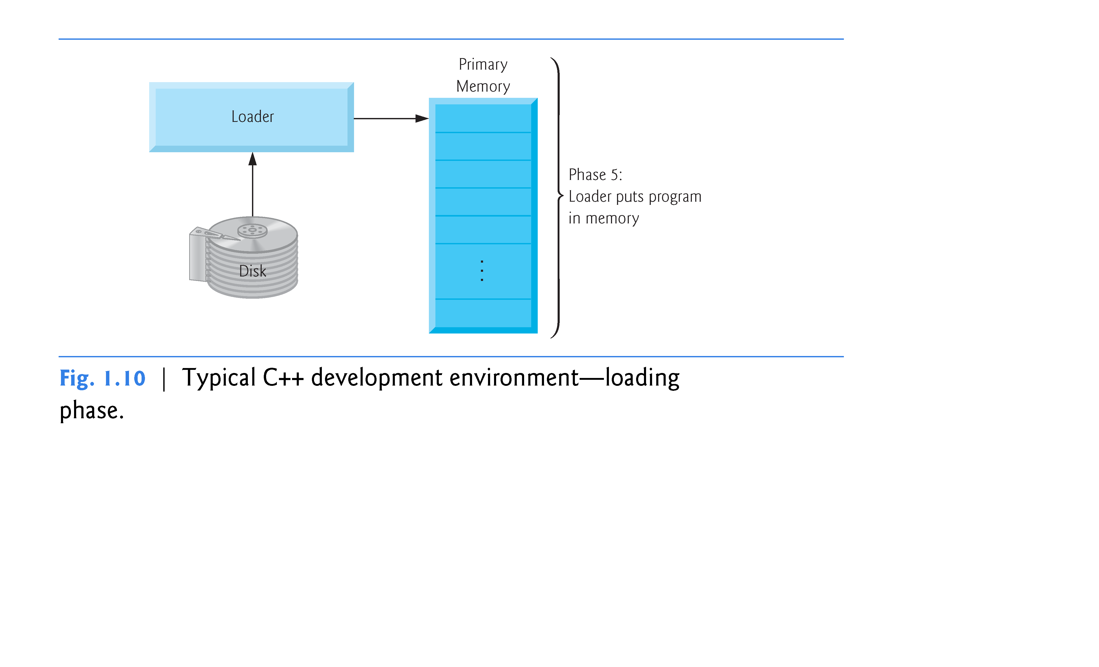

Slide 58
1.9 Typical C++ Development Environment (Cont.)
Phase 6: Execution
Finally, the computer, under the control of its CPU, executes the program one instruction at a time.
Some modern computer architectures can execute several instructions in parallel.

Slide 59
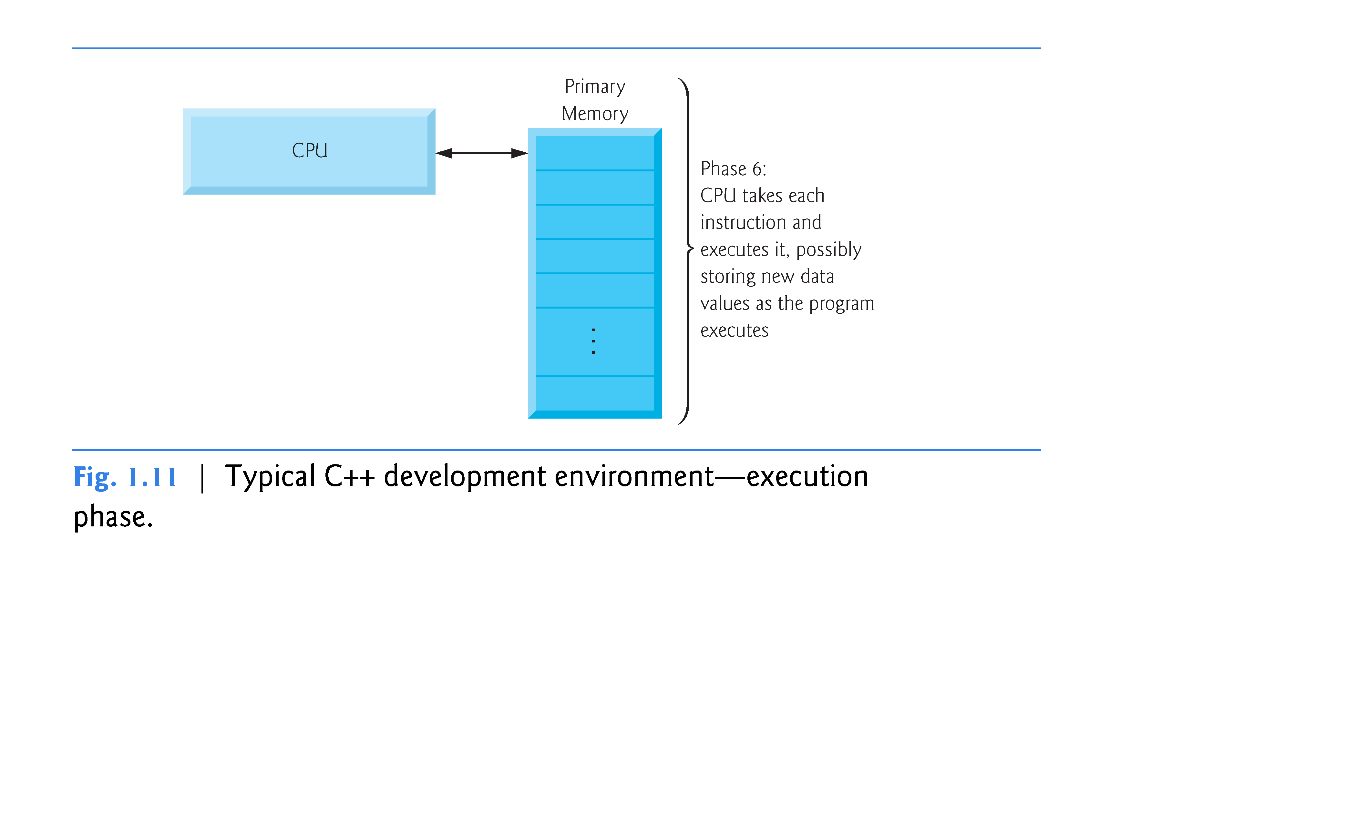

Slide 60
1.9 Typical C++ Development Environment (Cont.)
Problems That May Occur at Execution Time
Programs might not work on the first try.
Each of the preceding phases can fail because of various errors that we’ll discuss throughout this book.
If this occurred, you’d have to return to the edit phase, make the necessary corrections and proceed through the remaining phases again to determine that the corrections fixed the problem(s).
Most programs in C++ input or output data.

Slide 61
1.9 Typical C++ Development Environment (Cont.)
Certain C++ functions take their input from cin (the standard input stream; pronounced “see-in”), which is normally the keyboard, but cin can be redirected to another device.
Data is often output to cout (the standard output stream; pronounced “see-out”), which is normally the computer screen, but cout can be redirected to another device.
When we say that a program prints a result, we normally mean that the result is displayed on a screen.

Slide 62
1.9 Typical C++ Development Environment (Cont.)
Data may be output to other devices, such as disks and hardcopy printers.
There is also a standard error stream referred to as cerr. The cerr stream is used for displaying error messages.

Slide 63
1.11 Operating Systems
Operating systems
Software systems that make using computers more convenient for users, application developers and system administrators.
Provide services that allow each application to execute safely, efficiently and concurrently (i.e., in parallel) with other applications.
The software that contains the core components of the operating system is called the kernel.
Popular desktop operating systems include Linux, Windows and OS X (formerly called Mac OS X).
Popular mobile operating systems used in smartphones and tablets include Google’s Android, Apple’s iOS (for iPhone, iPad and iPod Touch devices), BlackBerry OS and Windows Phone.

Slide 64
1.11.1 Windows—A Proprietary Operating System
Mid-1980s, Microsoft developed the Windows operating system, consisting of a graphical user interface built on top of DOS—an enormously popular personal-computer operating system of the time that users interacted with by typing commands.
Windows borrowed from many concepts (such as icons, menus and windows) developed by Xerox PARC and popularized by early Apple Macintosh operating systems.

Slide 65
1.11.1 Windows—A Proprietary Operating System (Cont.)
Windows 8 is Microsoft’s latest operating system—its features include enhancements to the user interface, faster startup times, further refinement of security features, touch-screen and multi-touch support, and more.
Windows is a proprietary operating system—it’s controlled by Microsoft exclusively.
Windows is by far the world’s most widely used operating system.

Slide 66
1.11.2 Linux—An Open-Source Operating System
Open-source software
A software development style that departs from the proprietary development that dominated software’s early years.
Individuals and companies contribute their efforts in developing, maintaining and evolving software in exchange for the right to use that software for their own purposes, typically at no charge.

Slide 67
1.11.2 Linux—An Open-Source Operating System (Cont.)
Some key organizations in the open-source community are
Eclipse Foundation (the Eclipse Integrated Development Environment helps C++ programmers conveniently develop software)
Mozilla Foundation (creators of the Firefox web browser)
Apache Software Foundation (creators of the Apache web server used to develop web-based applications)
SourceForge (which provides the tools for managing open source projects—it has hundreds of thousands of them under development).
Facebook, which was launched from a college dorm room and built with open-source software.

Slide 68
1.11.2 Linux—An Open-Source Operating System (Cont.)
Linux
The most popular open-source operating system.
Developed by volunteers
Popular in servers, personal computers and embedded systems.
Source code is available to the public for examination and modification
Free to download and install.
Ability to completely customize the operating system to meet specific needs.
Linux has become extremely popular on servers and in embedded systems, such as Google’s Android-based smartphones.

Slide 69
1.11.3 Apple’s OS X; Apple’s iOS for iPhone ®, iPad® and iPod Touch ® Devices
In 1979, Steve Jobs and several Apple employees visited Xerox PARC (Palo Alto Research Center) to learn about Xerox’s desktop computer that featured a graphical user interface (GUI).
That GUI served as the inspiration for the Apple Macintosh, launched with much fanfare in a memorable Super Bowl ad in 1984.

Slide 70
1.11.3 Apple’s OS X; Apple’s iOS for iPhone ®, iPad® and iPod Touch ® Devices (Cont.)
Objective-C Programming Language
Created by Brad Cox and Tom Love at Stepstone in the early 1980s, added capabilities for object-oriented programming (OOP) to the C programming language.
Steve Jobs left Apple in 1985 and founded NeXT Inc.
In 1988, NeXT licensed Objective-C from StepStone and developed an Objective-C compiler and libraries which were used as the platform for the NeXTSTEP operating system’s user interface and Interface Builder—used to construct graphical user interfaces.

Slide 71
1.11.3 Apple’s OS X; Apple’s iOS for iPhone ®, iPad® and iPod Touch ® Devices (Cont.)
Jobs returned to Apple in 1996 when Apple bought NeXT.
Apple’s OS X operating system is a descendant of NeXTSTEP.
Apple’s proprietary operating system, iOS, is derived from Apple’s OS X and is used in the iPhone, iPad and iPod Touch devices.

Slide 72
1.11.4 Google’s Android
Android
Fastest growing mobile and smartphone operating system
Based on the Linux kernel and Java.
Open source and free.
Developed by Android, Inc., which was acquired by Google in 2005.
As of June 2012, more than 900,000 Android devices were being activated each day. (mashable.com/2012/06/11/900000-android-devices/)
Android smartphones are now outselling iPhones.

Slide 73
1.12 The Internet and the World Wide Web
The Internet—a global network of computers—was made possible by the convergence of computing and communications technologies.
In the late 1960s, ARPA (the Advanced Research Projects Agency) rolled out blueprints for networking the main computer systems of about a dozen ARPA-funded universities and research institutions.
ARPA proceeded to implement the ARPANET, which eventually evolved into today’s Internet.
It rapidly became clear that communicating quickly and easily via electronic mail was the key early benefit of the ARPANET.

Slide 74
1.12 The Internet and the World Wide Web (Cont.)
Packet Switching
A primary goal for ARPANET was to allow multiple users to send and receive information simultaneously over the same communications paths (e.g., phone lines).
Packet switching
A technique in which digital data was sent in small bundles called packets.
Packets contained address, error-control and sequencing information.
The address information allowed packets to be routed to their destinations.

Slide 75
1.12 The Internet and the World Wide Web (Cont.)
The sequencing information helped in reassembling the packets—which, because of complex routing mechanisms, could arrive out of order—into their original order for presentation to the recipient.
Packets from different senders were intermixed on the same lines to efficiently use the available bandwidth.
This packet-switching technique greatly reduced transmission costs, as compared with the cost of dedicated communications lines.
The network was designed to operate without centralized control.
If a portion of the network failed, the remaining working portions would still route packets from senders to receivers over alternative paths for reliability.

Slide 76
1.12 The Internet and the World Wide Web (Cont.)
TCP/IP
The protocol (i.e., set of rules) for communicating over the ARPANET became known as TCP—the Transmission Control Protocol.
Ensured that messages were properly routed from sender to receiver and that they arrived intact.
As the Internet evolved, organizations worldwide were implementing their own networks.
One challenge was to get these different networks to communicate.

Slide 77
1.12 The Internet and the World Wide Web (Cont.)
ARPA accomplished this with the development of IP—the Internet Protocol, truly creating a network of networks, the current architecture of the Internet.
The combined set of protocols is now commonly called TCP/IP.

Slide 78
1.12 The Internet and the World Wide Web (Cont.)
World Wide Web, HTML, HTTP
World Wide Web—allows you to locate and view multimedia-based documents on almost any subject over the Internet.
In 1989, Tim Berners-Lee of CERN (the European Organization for Nuclear Research) began to develop a technology for sharing information via hyperlinked text documents—called the HyperText Markup Language (HTML).
He also wrote communication protocols to form the backbone of his new information system, which he called the World Wide Web.

Slide 79
1.12 The Internet and the World Wide Web (Cont.)
Hypertext Transfer Protocol (HTTP)—a communications protocol used to send information over the web.
URL (Uniform Resource Locator)—specifies the address (i.e., location) of the web page displayed in the browser window.
Each web page on the Internet is associated with a unique URL.
Hypertext Transfer Protocol Secure (HTTPS) is the standard for transferring encrypted data on the web.

Slide 80
1.12 The Internet and the World Wide Web (Cont.)
Mosaic, Netscape, Emergence of Web 2.0
Web use exploded with the availability in 1993 of the Mosaic browser, which featured a user-friendly graphical interface.
Marc Andreessen, whose team at the National Center for Supercomputing Applications developed Mosaic, went on to found Netscape, the company that many people credit with igniting the explosive Internet economy of the late 1990s.
In 2003 there was a noticeable shift in how people and businesses were using the web and developing web-based applications. The term Web 2.0 was coined by Dale Dougherty of O’Reilly Media in 2003 to describe this trend.
Web 2.0 companies use the web as a platform to create collaborative, community-based sites (e.g., social networking sites, blogs, wikis).

Slide 81
1.12 The Internet and the World Wide Web (Cont.)
Companies with Web 2.0 characteristics are Google (search), YouTube (video sharing), FaceBook (social networking), Twitter (microblogging), Groupon (social commerce), Foursquare (mobile check-in), Salesforce (business software offered as online services “in the cloud”), Craigslist (mostly free classified listings), Flickr (photo sharing), Skype (Internet telephony and video conference calling) and Wikipedia (a free online encyclopedia).

Slide 82
1.12 The Internet and the World Wide Web (Cont.)
Architecture of Participation
Web 2.0 embraces an architecture of participation—a design that encourages user interaction and community contributions.
You, the user, are the most important aspect of Web 2.0.
Shift away from a powerful few to an empowered many.
For websites like Facebook, Twitter, YouTube, eBay and Wikipedia users create the content, while the companies provide the platforms on which to enter, manipulate and share the information.

Slide 83
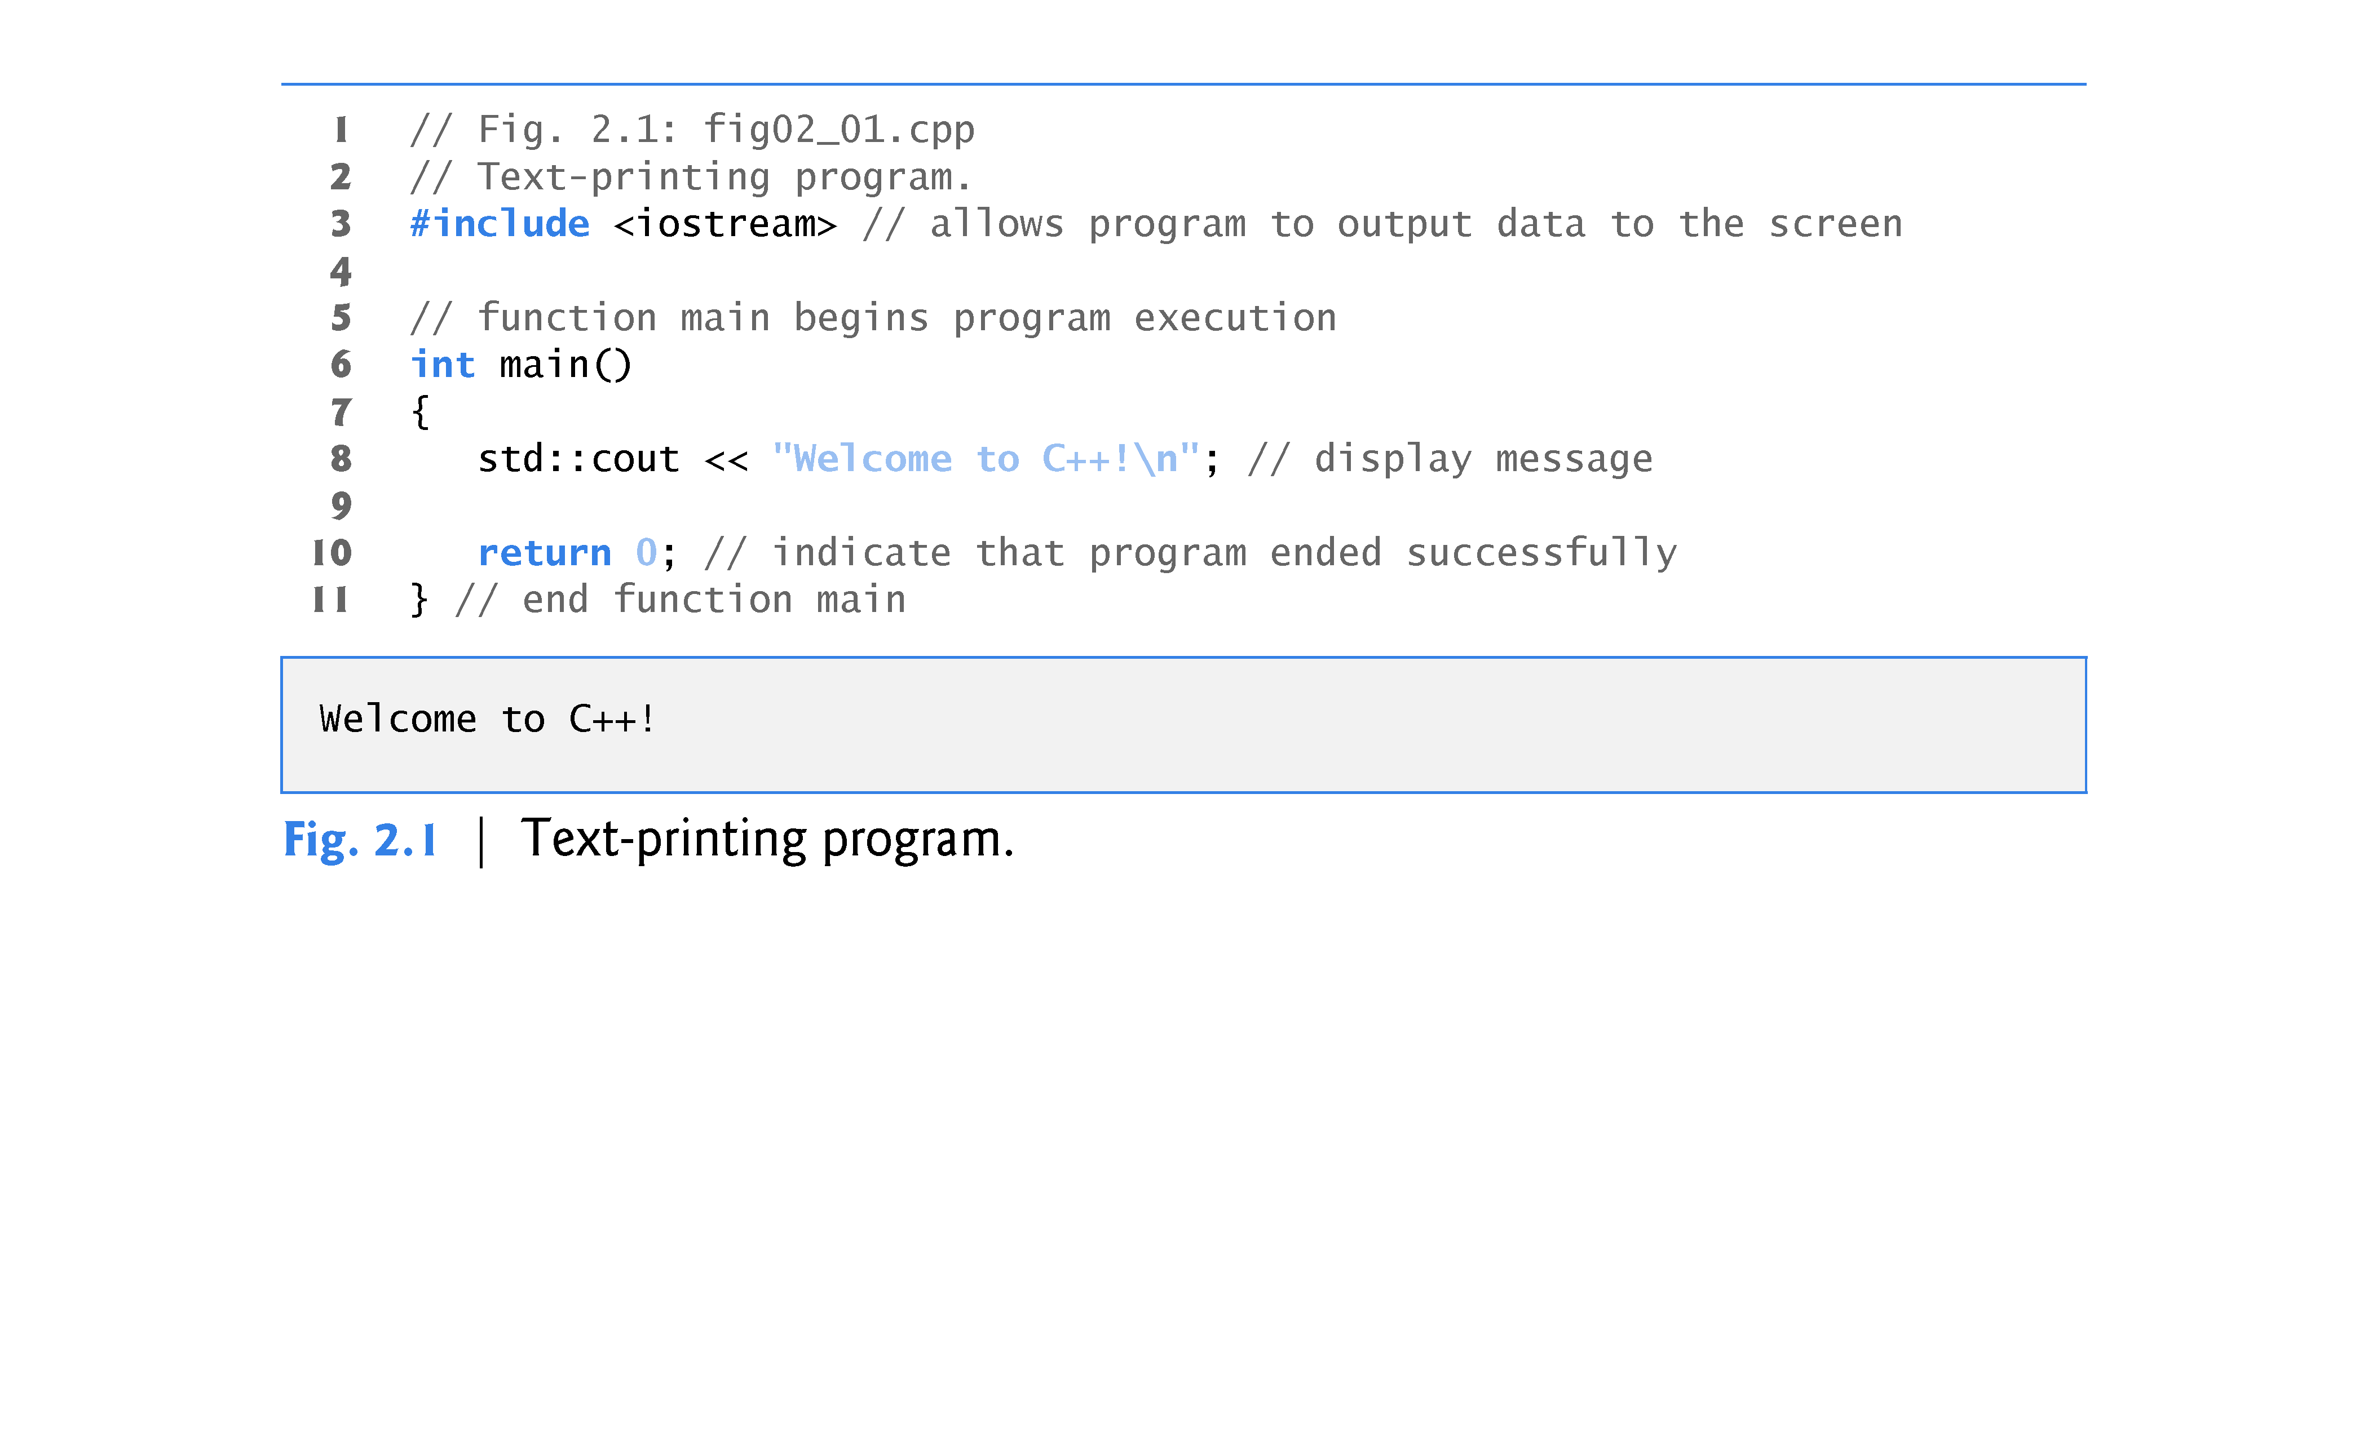
2.2 First Program in C++: Printing a Line of Text

Slide 84
2.2 First Program in C++: Printing a Line of Text (cont.)
// indicates that the remainder of each line is a comment.
You insert comments to document your programs and to help other people read and understand them.
Comments are ignored by the C++ compiler and do not cause any machine-language object code to be generated.
A comment beginning with // is called a single-line comment because it terminates at the end of the current line.
You also may use comments containing one or more lines enclosed in /* and */.

Slide 85
2.2 First Program in C++: Printing a Line of Text (cont.)
A preprocessing directive is a message to the C++ preprocessor.
Lines that begin with # are processed by the preprocessor before the program is compiled.
#include <iostream> notifies the preprocessor to include in the program the contents of the input/output stream header file <iostream>.
This header is a file containing information used by the compiler when compiling any program that outputs data to the screen or inputs data from the keyboard using C++-style stream input/output.

Slide 86
2.2 First Program in C++: Printing a Line of Text (cont.)
You use blank lines, space characters and tab characters (i.e., “tabs”) to make programs easier to read.
Together, these characters are known as white space.
White-space characters are normally ignored by the compiler.

Slide 87
2.2 First Program in C++: Printing a Line of Text (cont.)
main is a part of every C++ program.
The parentheses after main indicate that main is a program building block called a function.
C++ programs typically consist of one or more functions and classes.
Exactly one function in every program must be named main.
C++ programs begin executing at function main, even if main is not the first function defined in the program.
The keyword int to the left of main indicates that main “returns” an integer (whole number) value.
A keyword is a word in code that is reserved by C++ for a specific use.
For now, simply include the keyword int to the left of main in each of your programs.

Slide 88
2.2 First Program in C++: Printing a Line of Text (cont.)
A left brace, {, must begin the body of every function.
A corresponding right brace, }, must end each function’s body.
A statement instructs the computer to perform an action.
Together, the quotation marks and the characters between them are called a string, a character string or a string literal.
We refer to characters between double quotation marks simply as strings.
White-space characters in strings are not ignored by the compiler.
Most C++ statements end with a semicolon (;), also known as the statement terminator.
Preprocessing directives (like #include) do not end with a semicolon.

Slide 89
2.2 First Program in C++: Printing a Line of Text (cont.)
Typically, output and input in C++ are accomplished with streams of characters.
When a cout statement executes, it sends a stream of characters to the standard output stream object—std::cout—which is normally “connected” to the screen.
The std:: before cout is required when we use names that we’ve brought into the program by the preprocessing directive #include <iostream>.
The notation std::cout specifies that we are using a name, in this case cout, that belongs to “namespace” std.
The names cin (the standard input stream) and cerr (the standard error stream) also belong to namespace std.

Slide 90
2.2 First Program in C++: Printing a Line of Text (cont.)
In the context of an output statement, the << operator is referred to as the stream insertion operator.
The value to the operator’s right, the right operand, is inserted in the output stream.
The characters \n are not printed on the screen.
The backslash (\) is called an escape character.
It indicates that a “special” character is to be output.
When a backslash is encountered in a string of characters, the next character is combined with the backslash to form an escape sequence.
The escape sequence \n means newline.
Causes the cursor to move to the beginning of the next line on the screen.

Slide 91
2.2 First Program in C++: Printing a Line of Text (cont.)
When the return statement is used at the end of main the value 0 indicates that the program has terminated successfully.
According to the C++ standard, if program execution reaches the end of main without encountering a return statement, it’s assumed that the program terminated successfully—exactly as when the last statement in main is a return statement with the value 0.

Slide 92
2.3 Modifying Our First C++ Program
Welcome to C++! can be printed several ways.

Slide 93
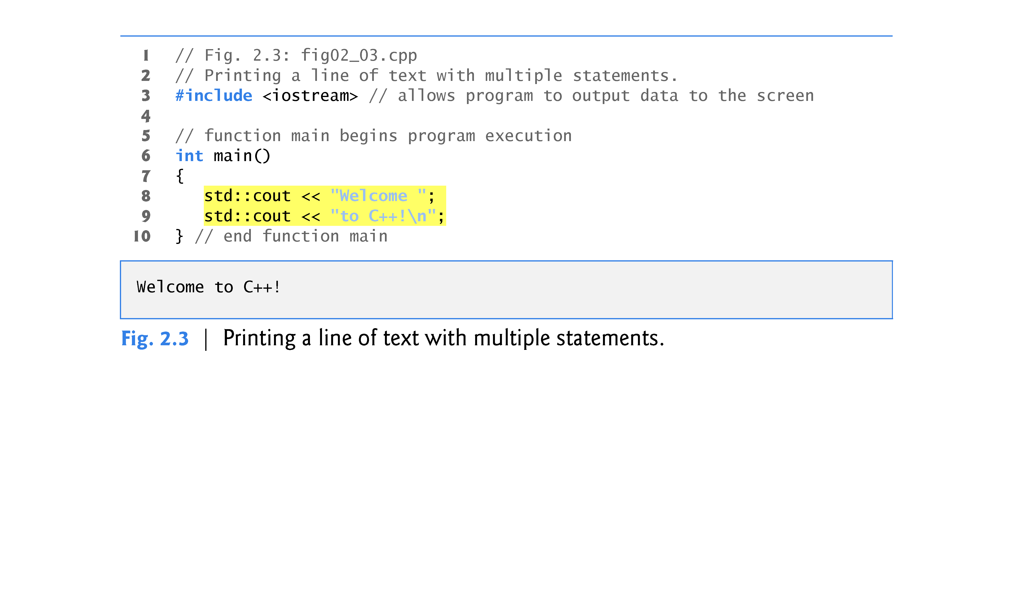

Slide 94
2.3 Modifying Our First C++ Program (cont.)
A single statement can print multiple lines by using newline characters.
Each time the \n (newline) escape sequence is encountered in the output stream, the screen cursor is positioned to the beginning of the next line.
To get a blank line in your output, place two newline characters back to back.

Slide 95
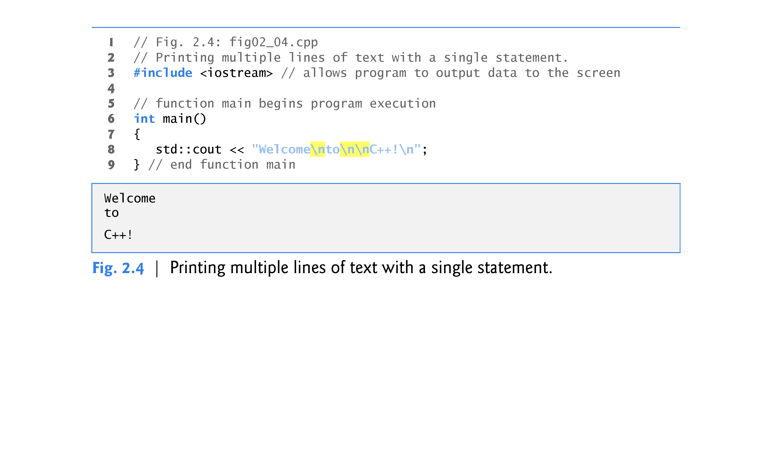

Slide 96
2.4 Another C++ Program: Adding Integers
The next program obtains two integers typed by a user at the keyboard, computes the sum of these values and outputs the result using std::cout.
Figure 2.5 shows the program and sample inputs and outputs.

Slide 97
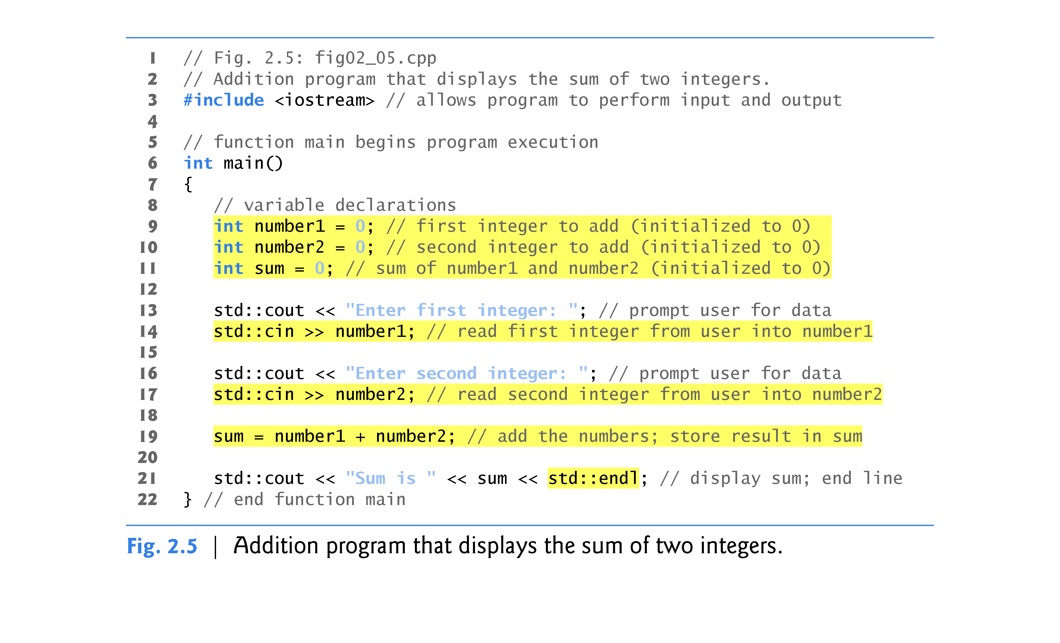

Slide 98
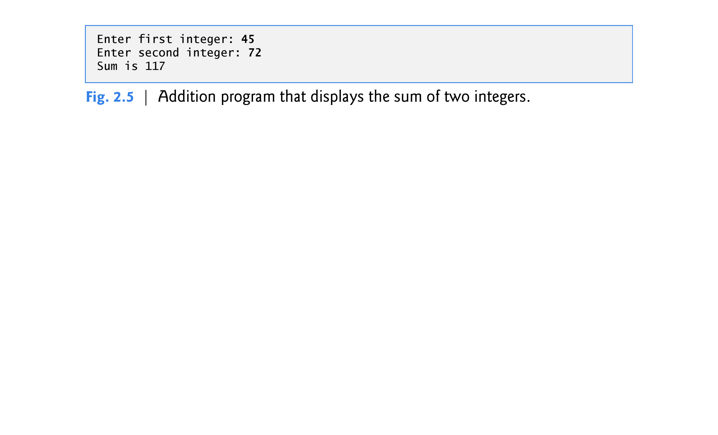

Slide 99
2.4 Another C++ Program: Adding Integers (cont.)
Declarations introduce identifiers into programs.
The identifiers number1, number2 and sum are the names of variables.
A variable is a location in the computer’s memory where a value can be stored for use by a program.
Variables number1, number2 and sum are data of type int, meaning that these variables will hold integer values, i.e., whole numbers such as 7, –11, 0 and 31914.
All variables must be declared with a name and a data type before they can be used in a program.
If more than one name is declared in a declaration (as shown here), the names are separated by commas (,); this is referred to as a comma-separated list.

Slide 100
2.4 Another C++ Program: Adding Integers (cont.)
Data type double is for specifying real numbers, and data type char for specifying character data.
Real numbers are numbers with decimal points, such as 3.4, 0.0 and –11.19.
A char variable may hold only a single lowercase letter, a single uppercase letter, a single digit or a single special character (e.g., $ or *).
Types such as int, double and char are called fundamental types.
Fundamental-type names are keywords and therefore must appear in all lowercase letters.
Appendix C contains the complete list of fundamental types.

Slide 101
2.4 Another C++ Program: Adding Integers (cont.)
A variable name is any valid identifier that is not a keyword.
An identifier is a series of characters consisting of letters, digits and underscores ( _ ) that does not begin with a digit.
C++ is case sensitive—uppercase and lowercase letters are different, so a1 and A1 are different identifiers.

Slide 102
2.4 Another C++ Program: Adding Integers (cont.)
A prompt it directs the user to take a specific action.
A cin statement uses the input stream object cin (of namespace std) and the stream extraction operator, >>, to obtain a value from the keyboard.
Using the stream extraction operator with std::cin takes character input from the standard input stream, which is usually the keyboard.

Slide 103
2.4 Another C++ Program: Adding Integers (cont.)
When the computer executes an input statement that places a value in an int variable, it waits for the user to enter a value for variable number1.
The user responds by typing the number (as characters) then pressing the Enter key (sometimes called the Return key) to send the characters to the computer.
The computer converts the character representation of the number to an integer and assigns (i.e., copies) this number (or value) to the variable number1.
Any subsequent references to number1 in this program will use this same value.

Slide 104
2.4 Another C++ Program: Adding Integers (cont.)
In this program, an assignment statement adds the values of variables number1 and number2 and assigns the result to variable sum using the assignment operator =.
Most calculations are performed in assignment statements.
The = operator and the + operator are called binary operators because each has two operands.

Slide 105
2.4 Another C++ Program: Adding Integers (cont.)
std::endl is a so-called stream manipulator.
The name endl is an abbreviation for “end line” and belongs to namespace std.
The std::endl stream manipulator outputs a newline, then “flushes the output buffer.”
This simply means that, on some systems where outputs accumulate in the machine until there are enough to “make it worthwhile” to display them on the screen, std::endl forces any accumulated outputs to be displayed at that moment.
This can be important when the outputs are prompting the user for an action, such as entering data.

Slide 106
2.4 Another C++ Program: Adding Integers (cont.)
Using multiple stream insertion operators (<<) in a single statement is referred to as concatenating, chaining or cascading stream insertion operations.
Calculations can also be performed in output statements.

Slide 107
2.5 Memory Concepts
Variable names such as number1, number2 and sum actually correspond to locations in the computer’s memory.
Every variable has a name, a type, a size and a value.
When a value is placed in a memory location, the value overwrites the previous value in that location; thus, placing a new value into a memory location is said to be destructive.
When a value is read out of a memory loca-tion, the process is nondestructive.

Slide 108
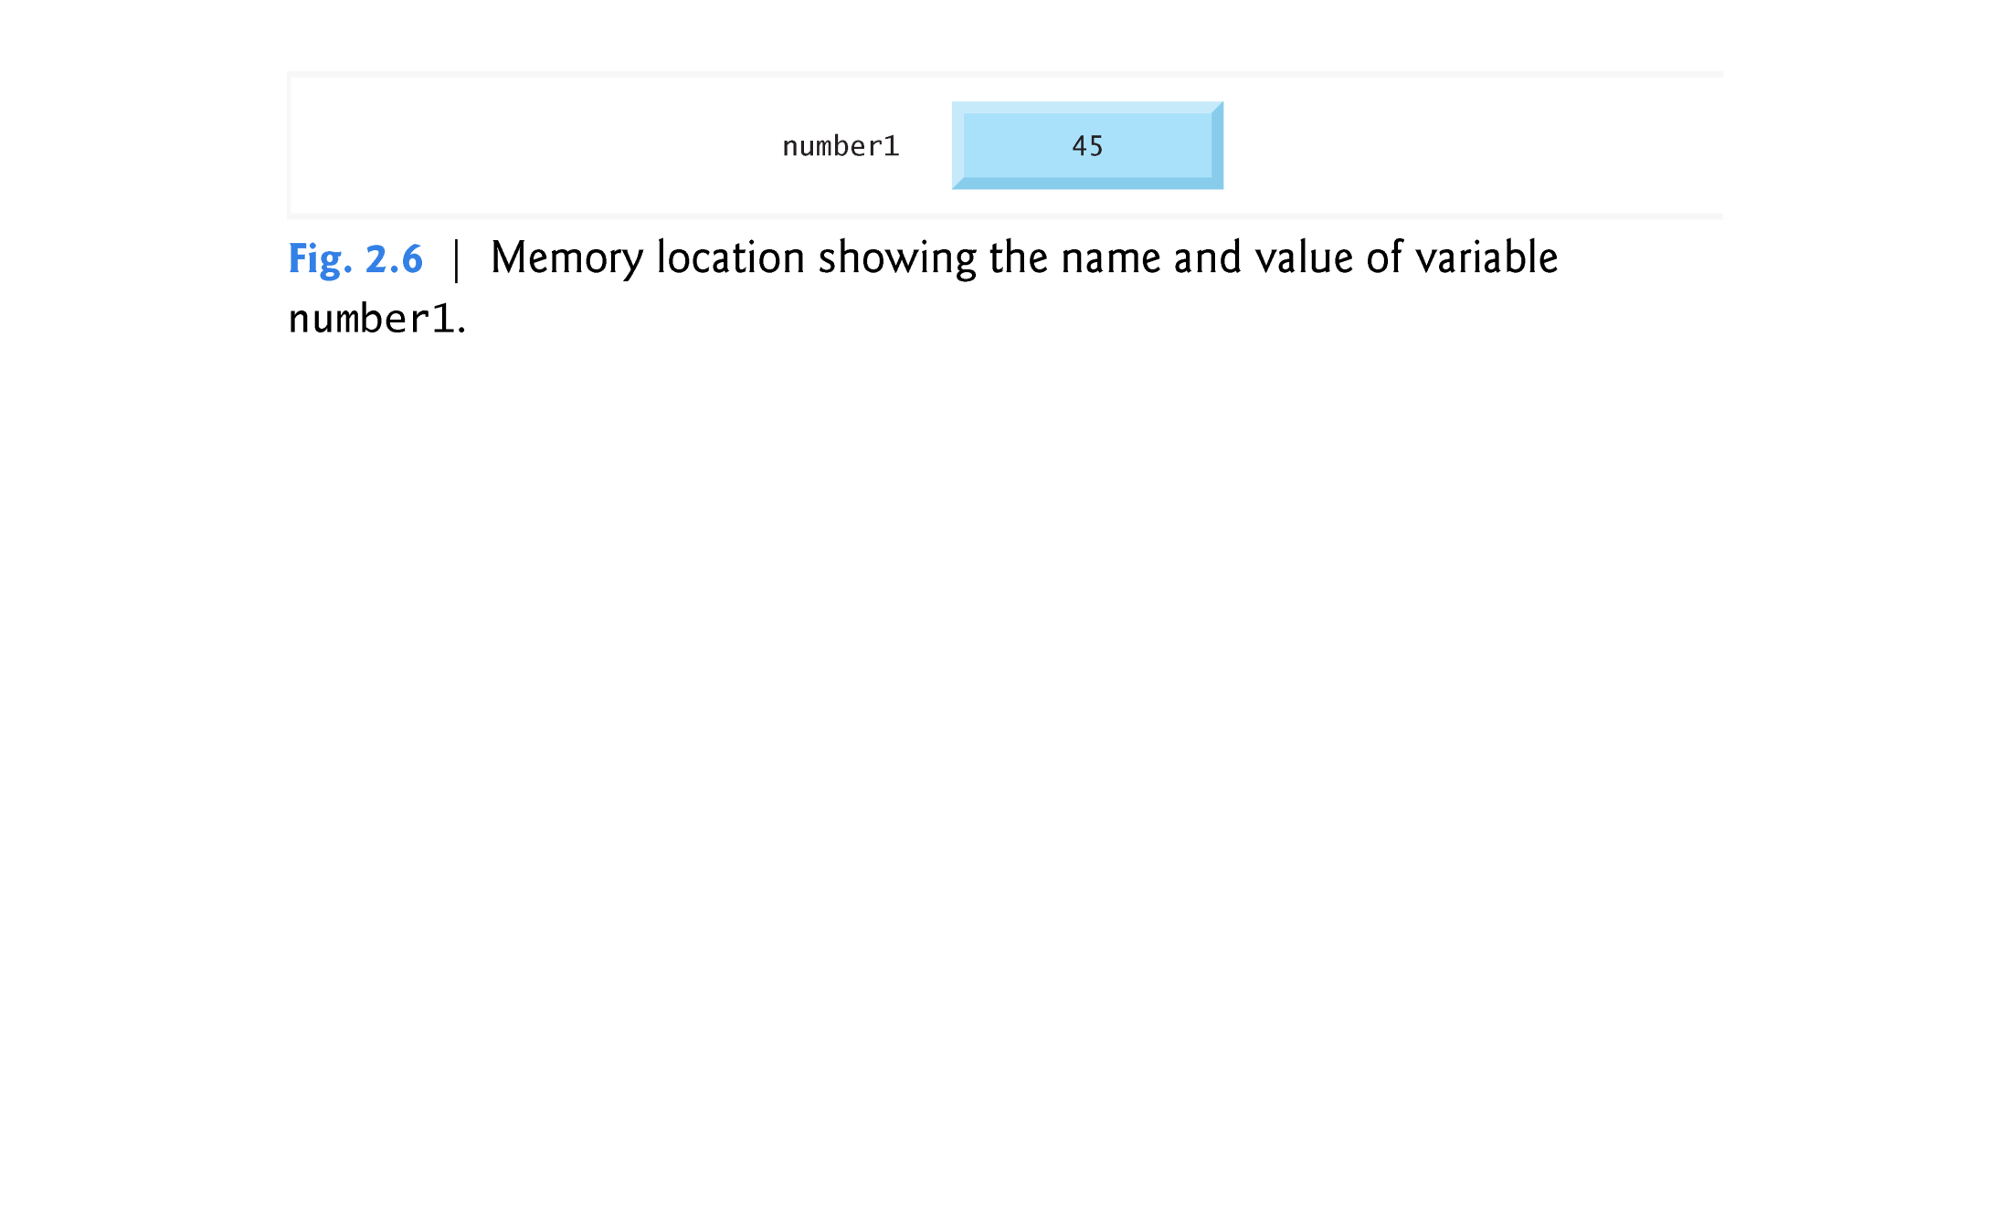

Slide 109
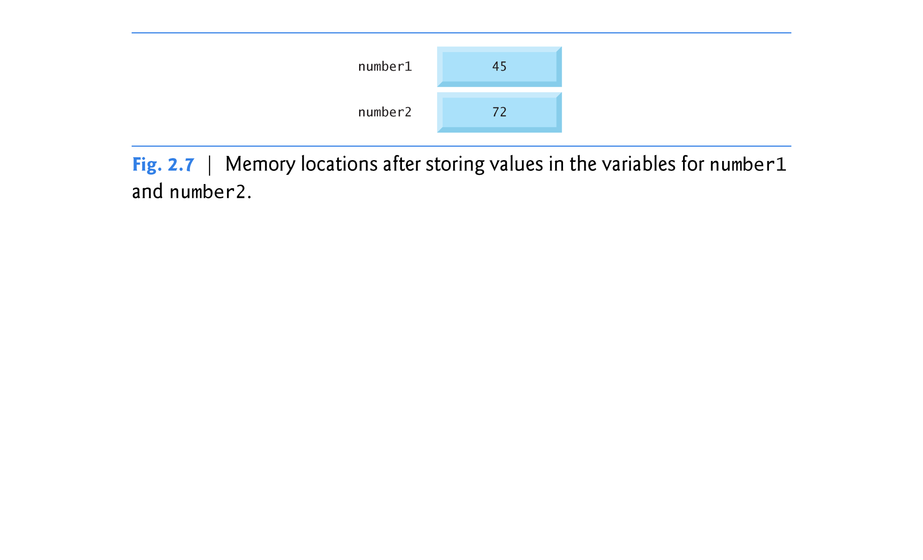

Slide 110
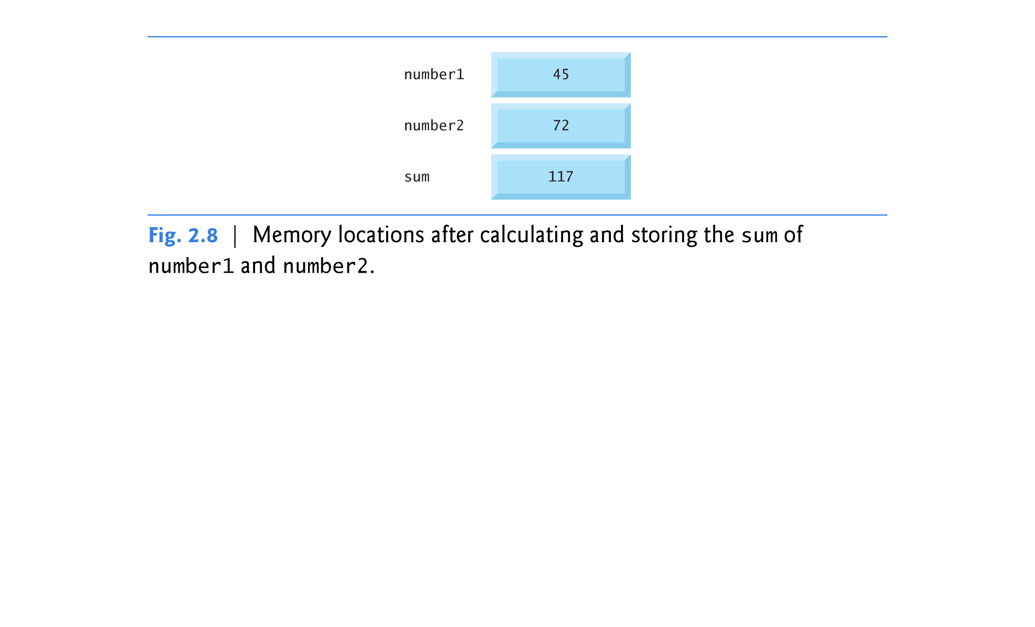

Slide 111
2.6 Arithmetic
Most programs perform arithmetic calculations.
Figure 2.9 summarizes the C++ arithmetic operators.
The asterisk (*) indicates multiplication.
The percent sign (%) is the modulus operator that will be discussed shortly.
C++ provides the modulus operator, %, that yields the remainder after integer division.
The modulus operator can be used only with integer operands.
The arithmetic operators in Fig. 2.9 are all binary operators.
Integer division (i.e., where both the numerator and the denominator are integers) yields an integer quotient.
Any fractional part in integer division is discarded (i.e., truncated)—no rounding occurs.

Slide 112
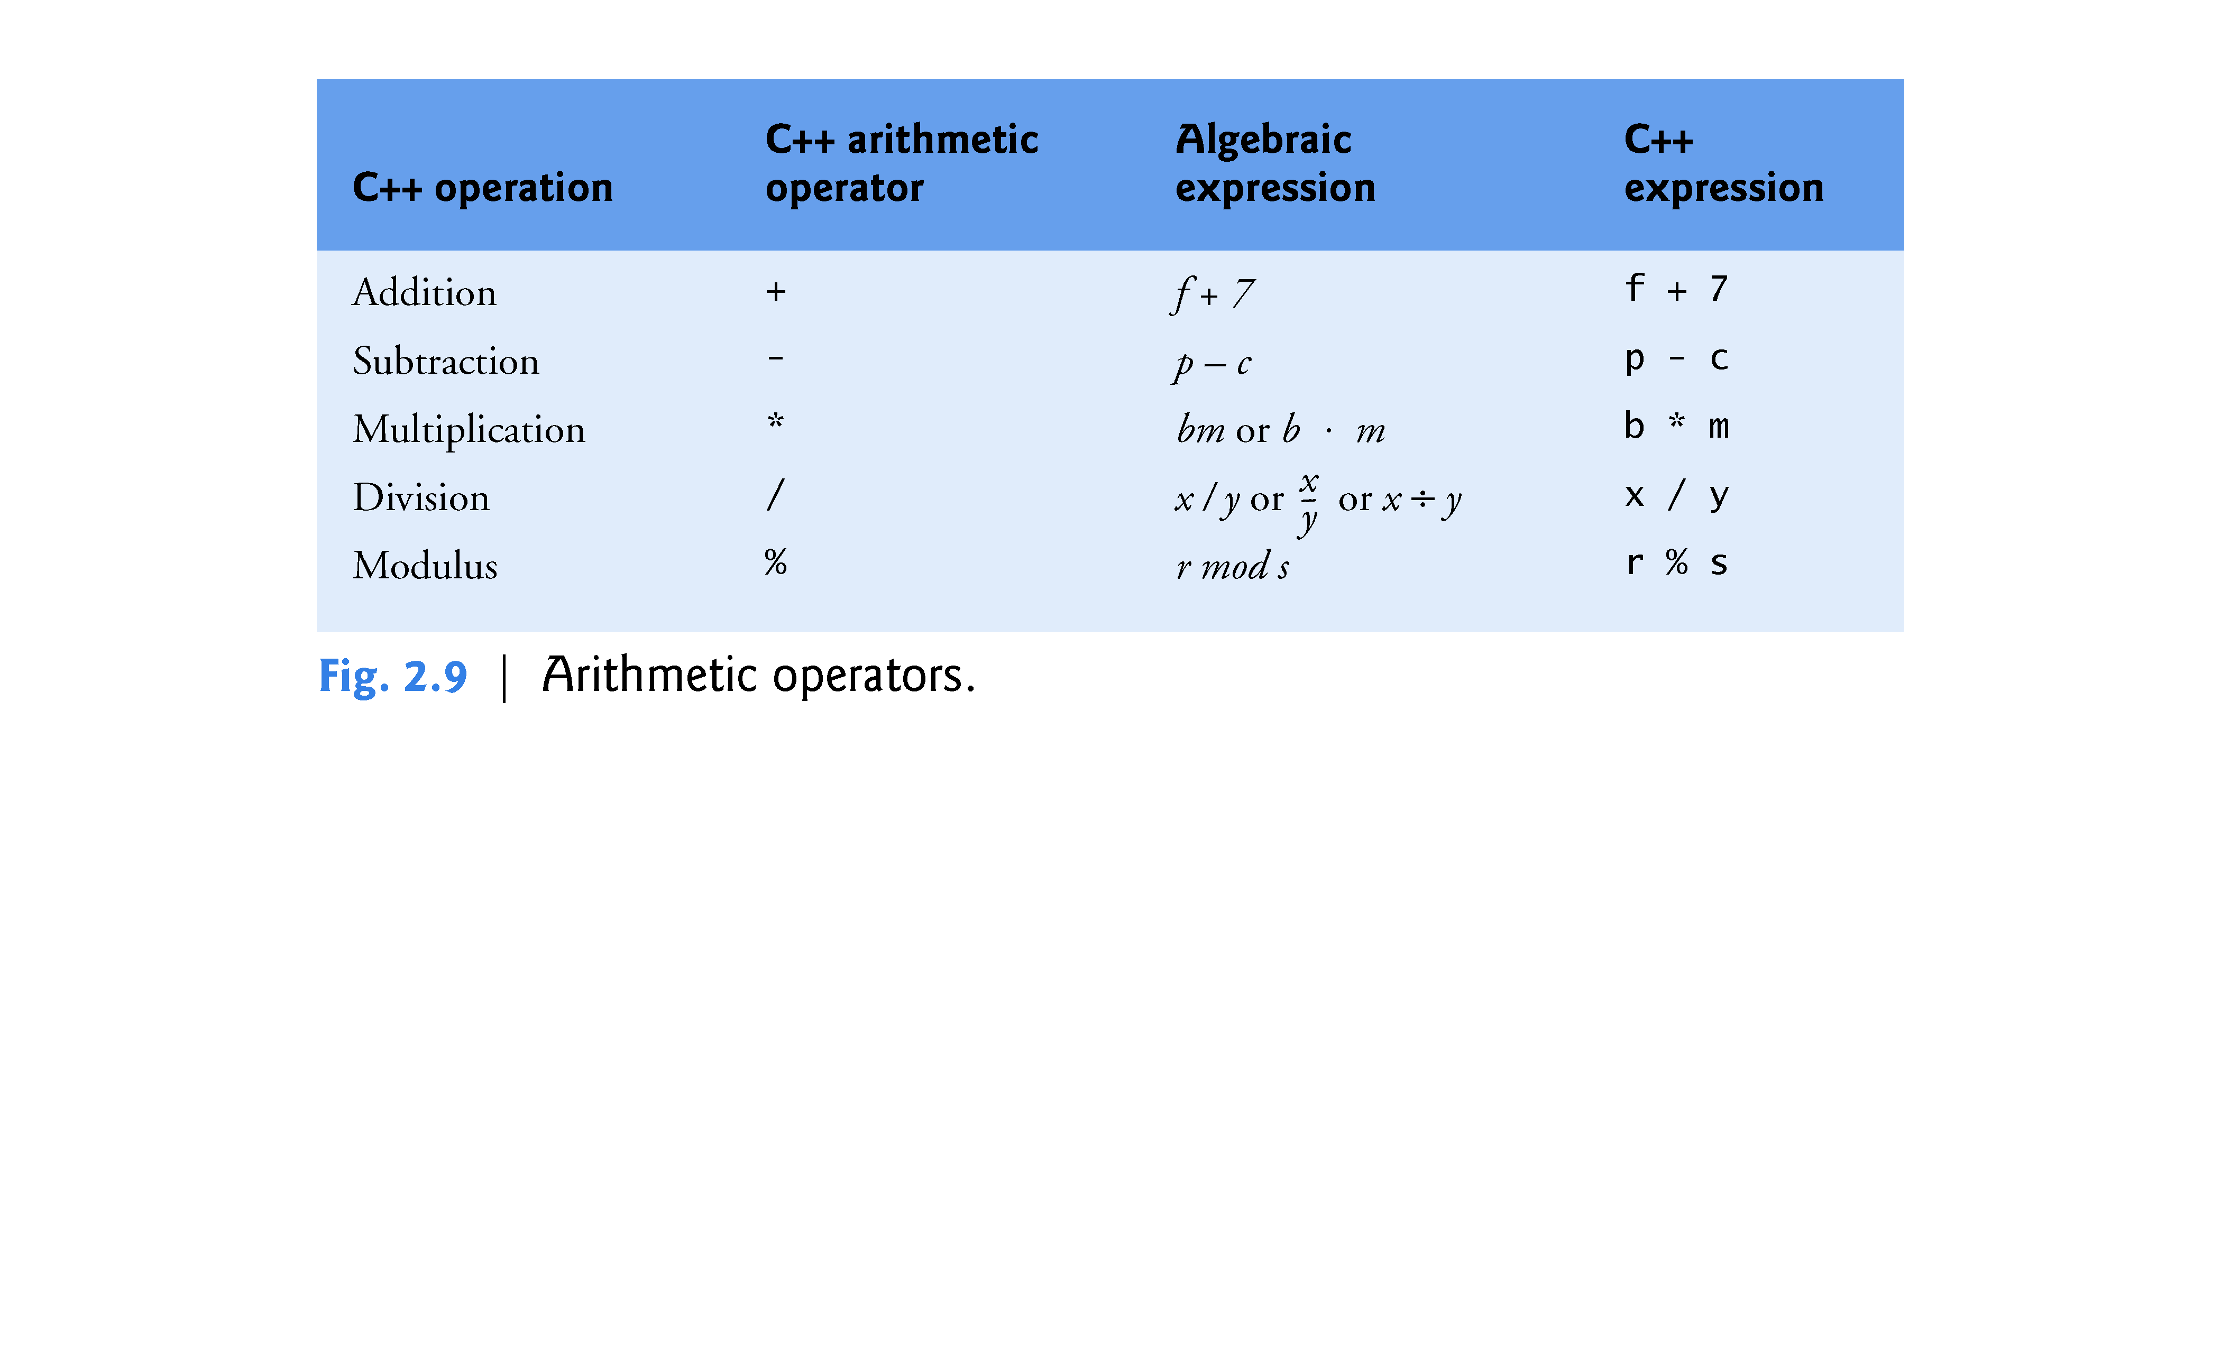

Slide 113
2.6 Arithmetic (cont.)
Arithmetic expressions in C++ must be entered into the computer in straight-line form.
Expressions such as “a divided by b” must be written as a / b, so that all constants, variables and operators appear in a straight line.
Parentheses are used in C++ expressions in the same manner as in algebraic expressions.
For example, to multiply a times the quantity b + c we write a a * ( b + c ).

Slide 114
2.6 Arithmetic (cont.)
C++ applies the operators in arithmetic expressions in a precise sequence determined by the following rules of operator precedence, which are generally the same as those followed in algebra.

Slide 115
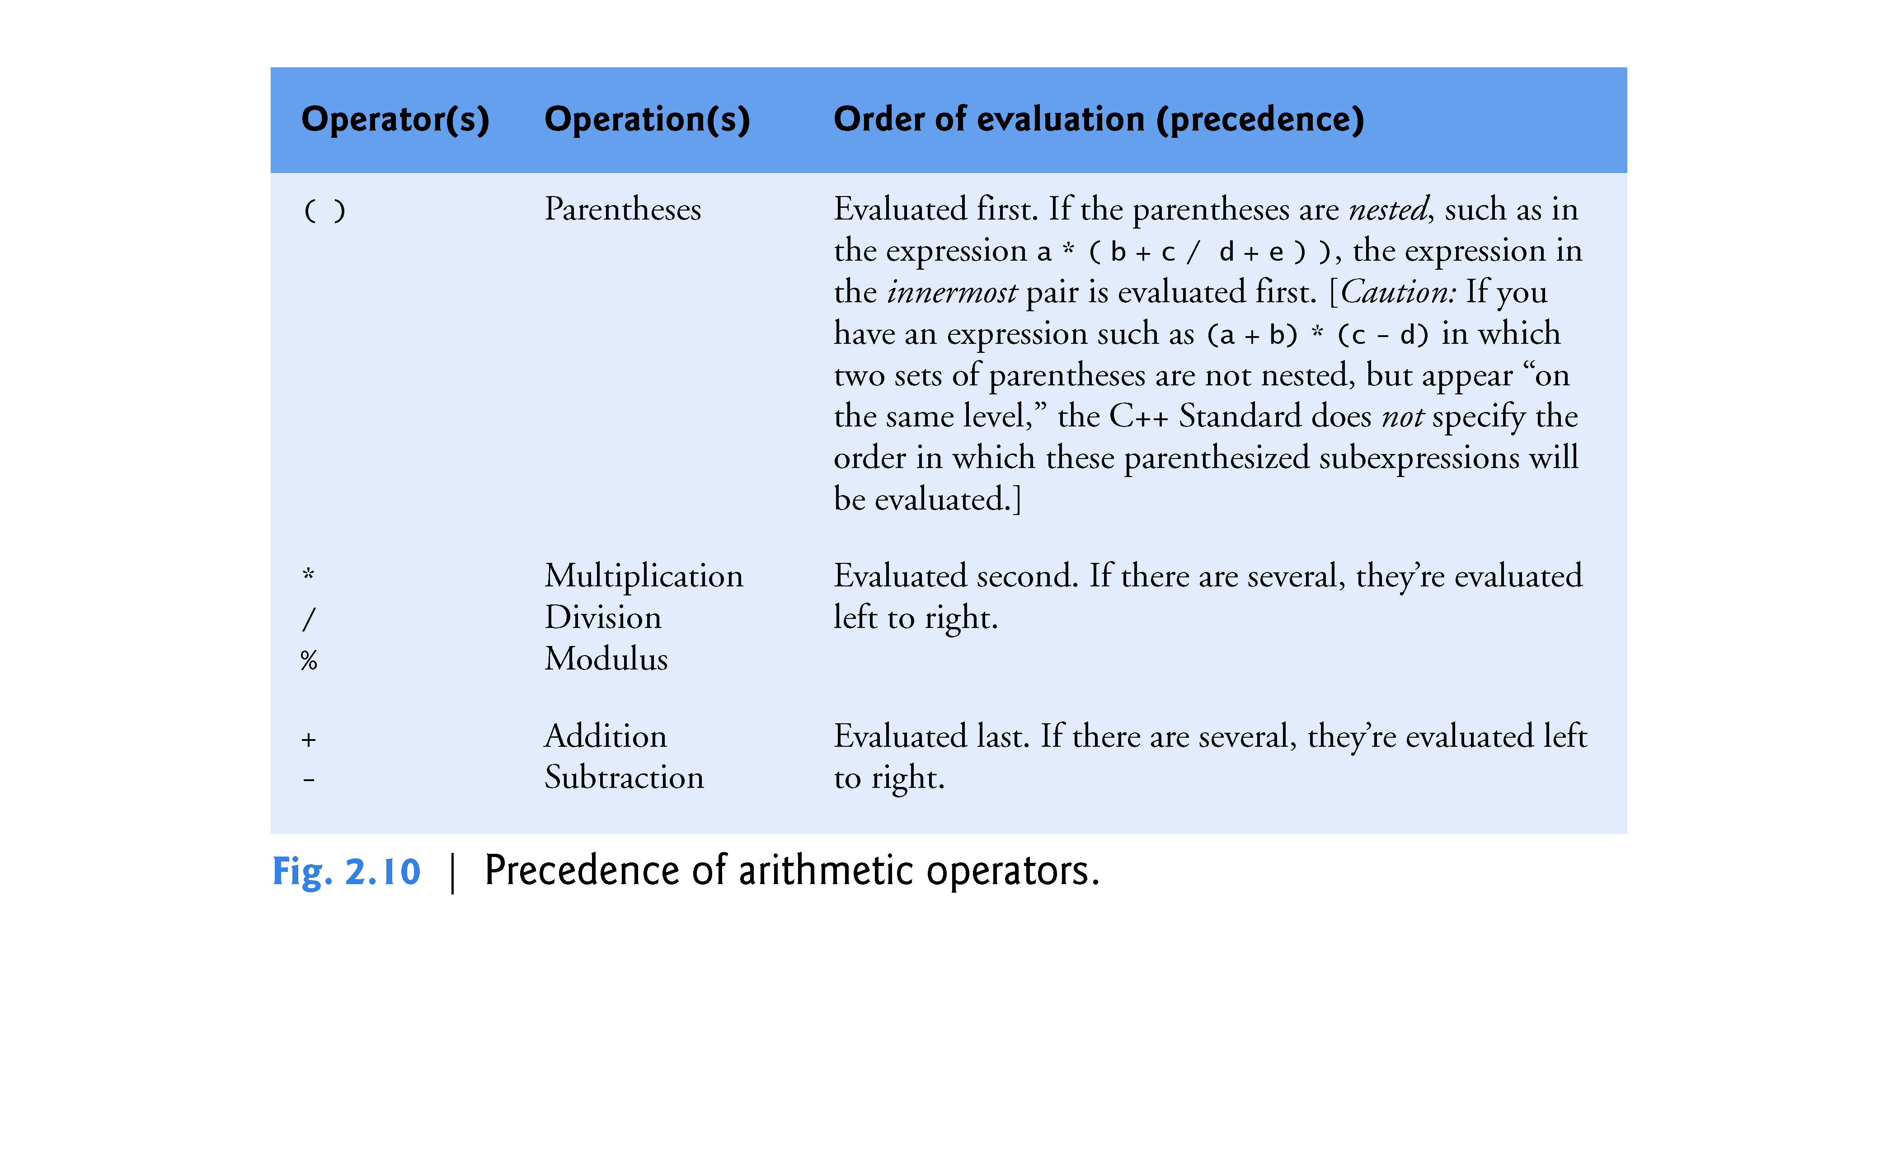

Slide 116
2.6 Arithmetic (cont.)
There is no arithmetic operator for exponentiation in C++, so x² is represented as x * x.
Figure 2.11 illustrates the order in which the operators in a second-degree polynomial are applied.
As in algebra, it’s acceptable to place unnecessary parentheses in an expression to make the expression clearer.
These are called redundant parentheses.

Slide 117
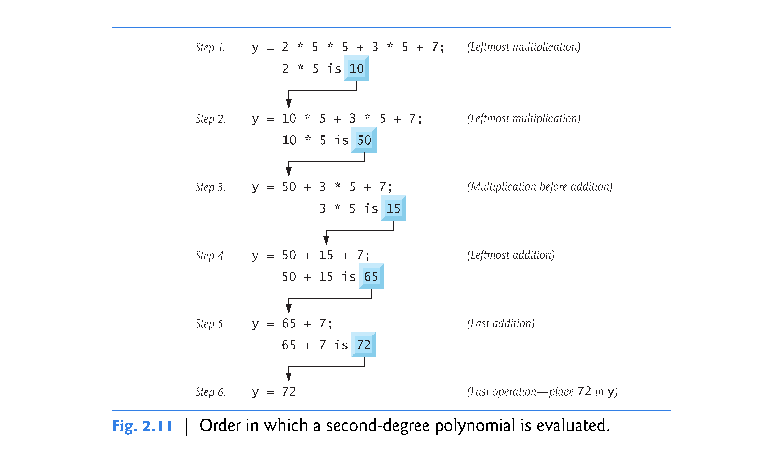

Slide 118
2.7 Decision Making: Equality and Relational Operators
The if statement allows a program to take alternative action based on whether a condition is true or false.
If the condition is true, the statement in the body of the if statement is executed.
If the condition is false, the body statement is not executed.
Conditions in if statements can be formed by using the equality operators and relational operators summarized in Fig. 2.12.
The relational operators all have the same level of precedence and associate left to right.
The equality operators both have the same level of precedence, which is lower than that of the relational operators, and associate left to right.

Slide 119
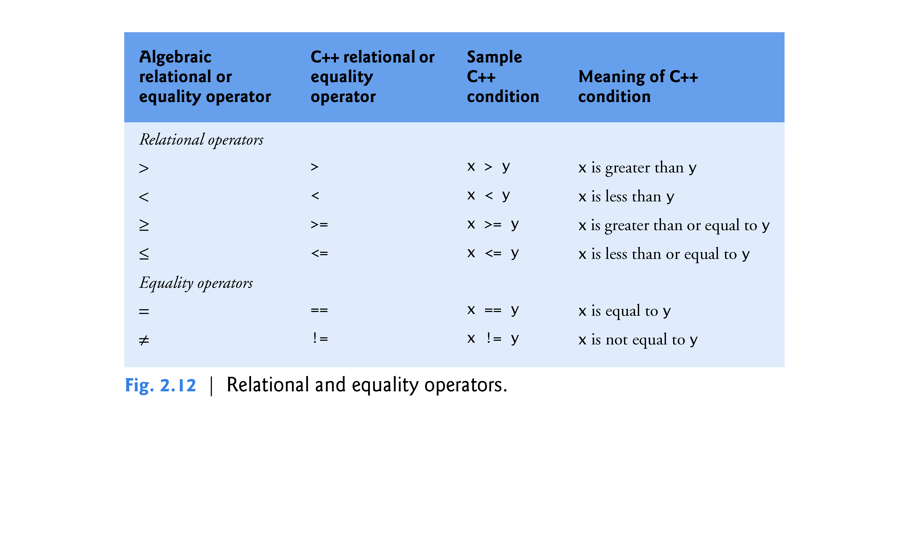

Slide 120
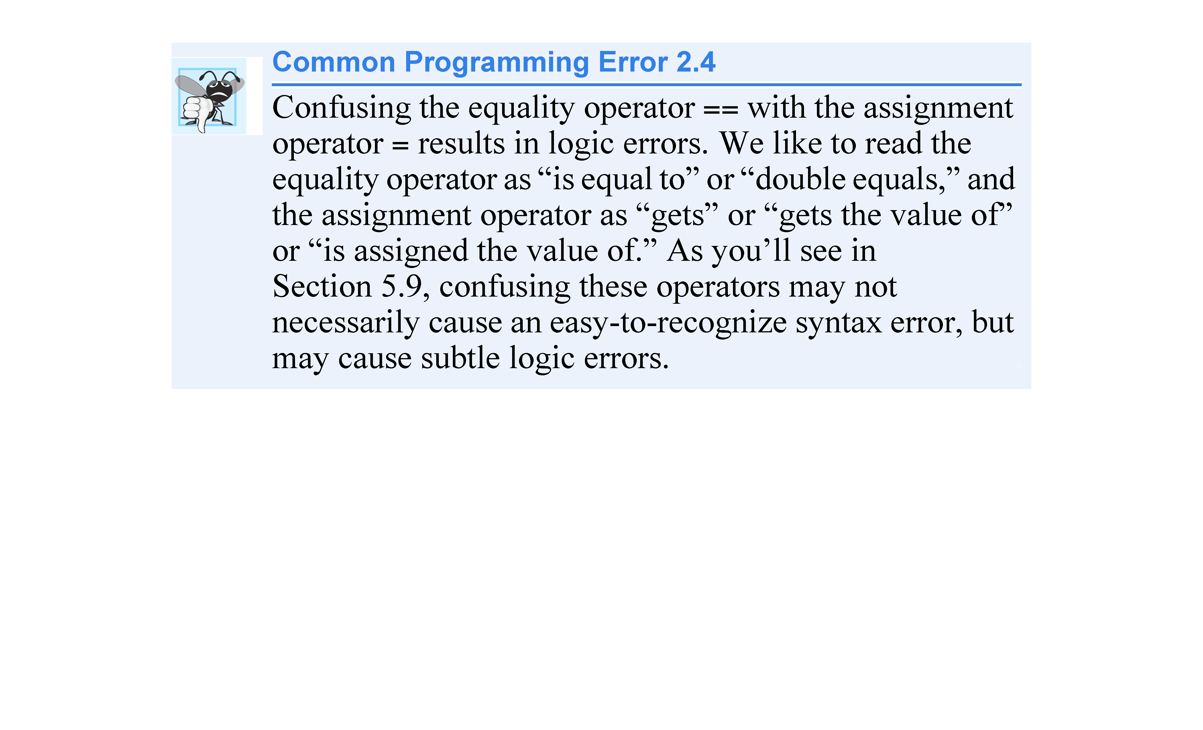

Slide 121
2.7 Decision Making: Equality and Relational Operators (cont.)
The following example uses six if statements to compare two numbers input by the user.
If the condition in any of these if statements is satisfied, the output statement as-sociated with that if statement is executed.
Figure 2.13 shows the program and the input/output dialogs of three sample executions.

Slide 122
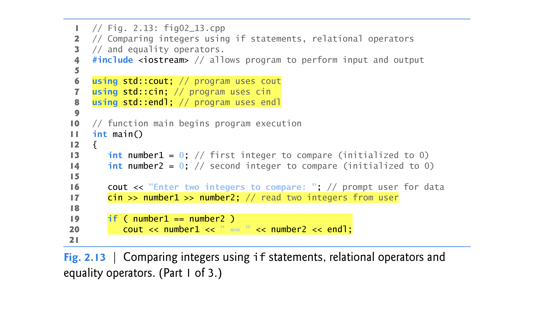

Slide 123
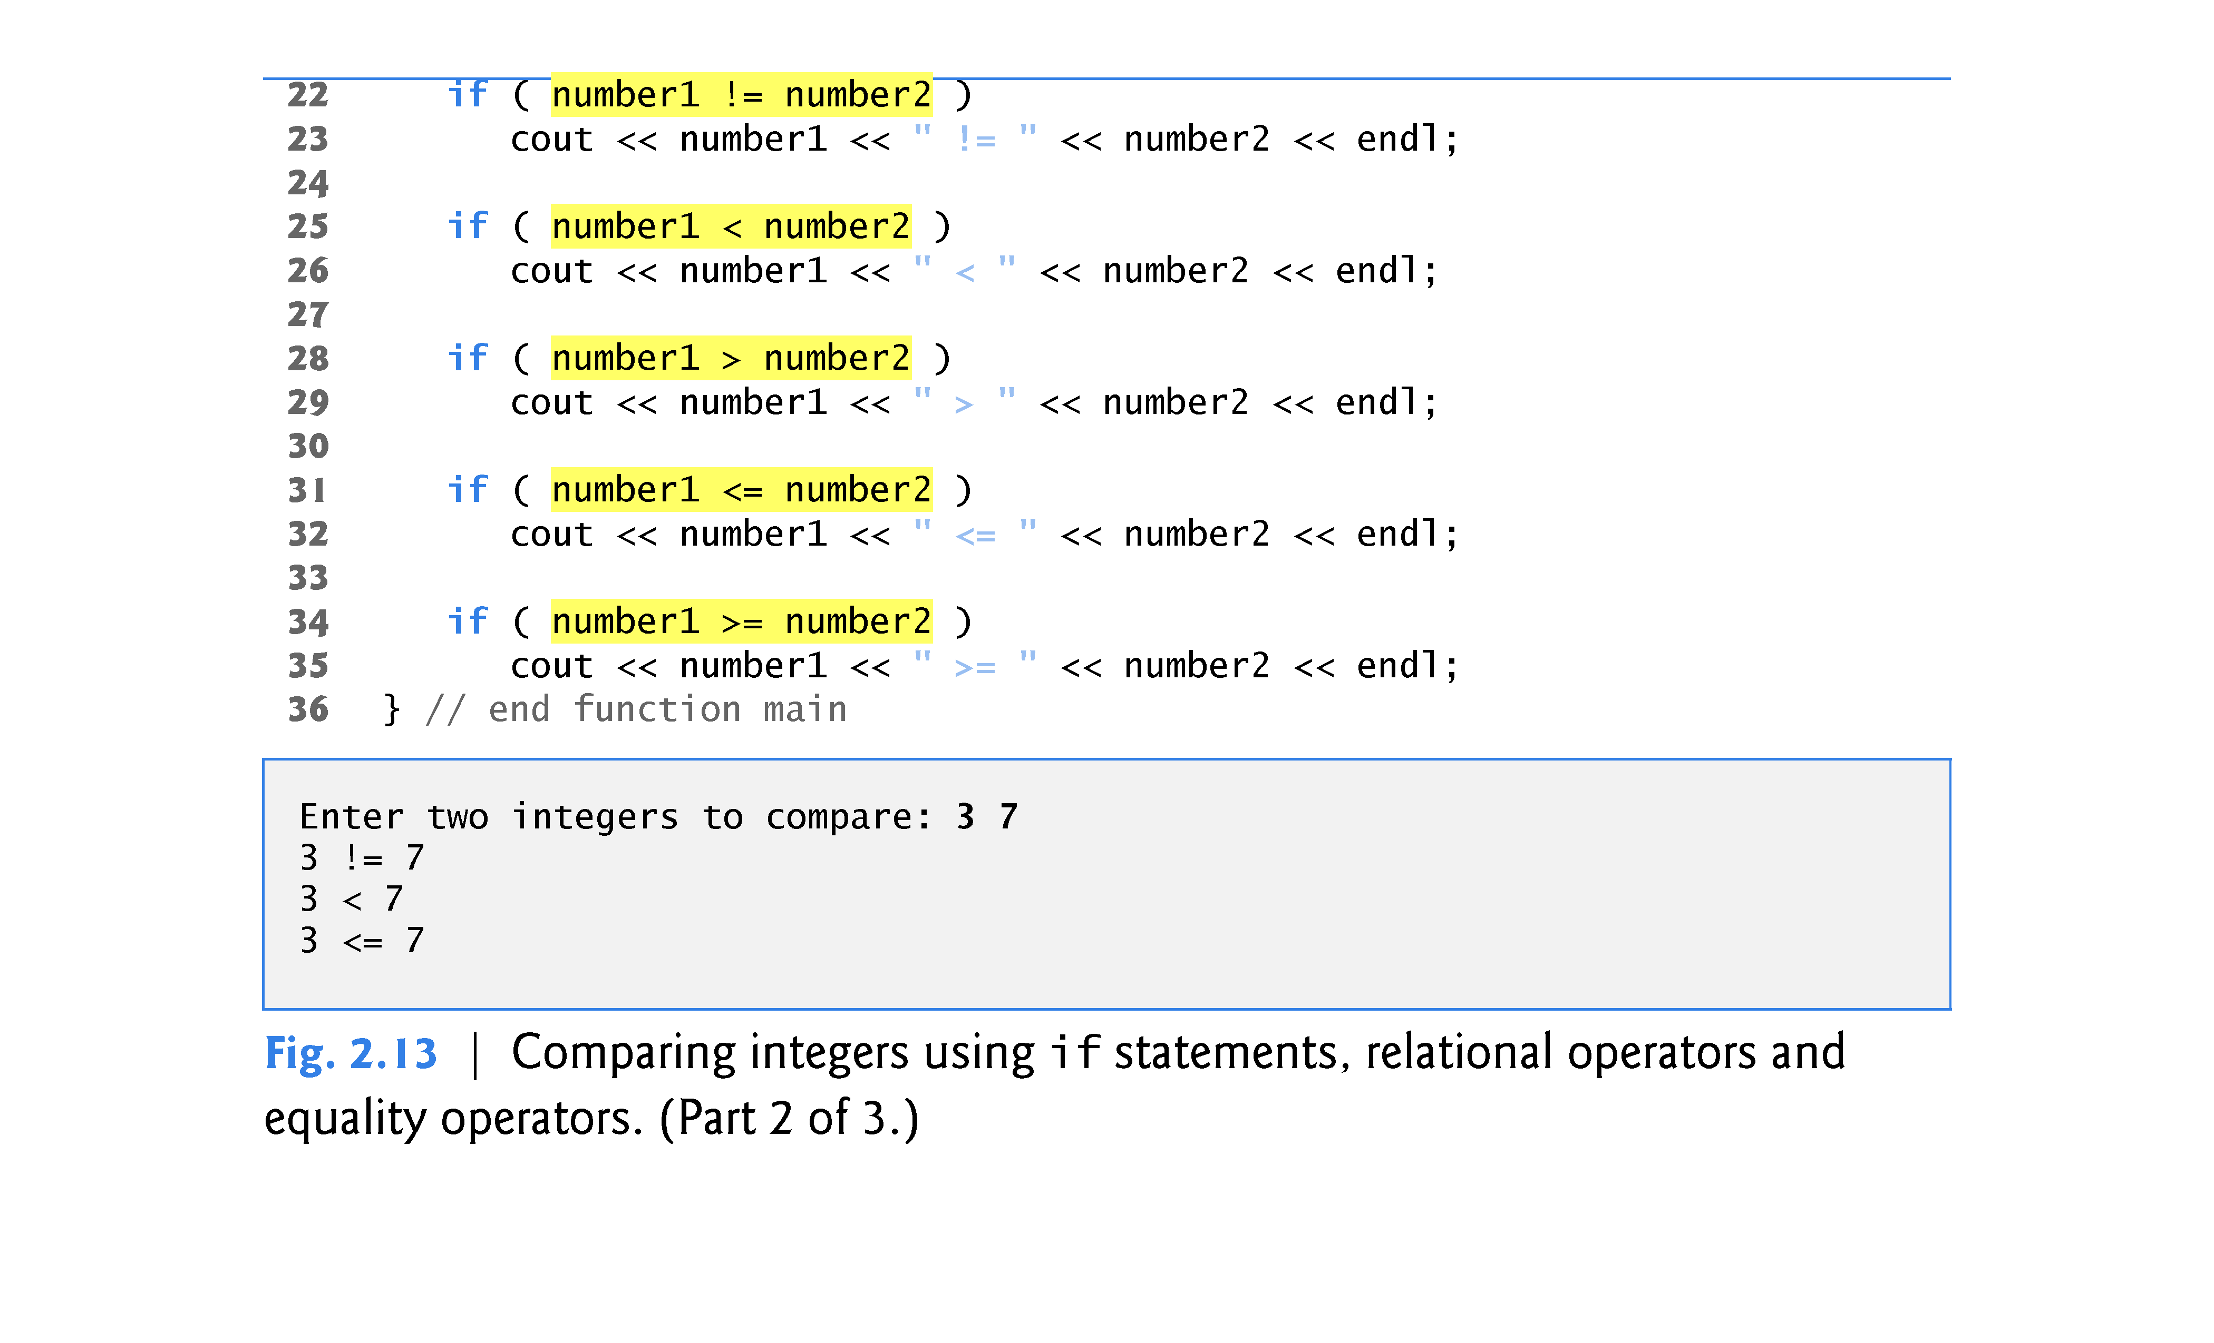

Slide 124
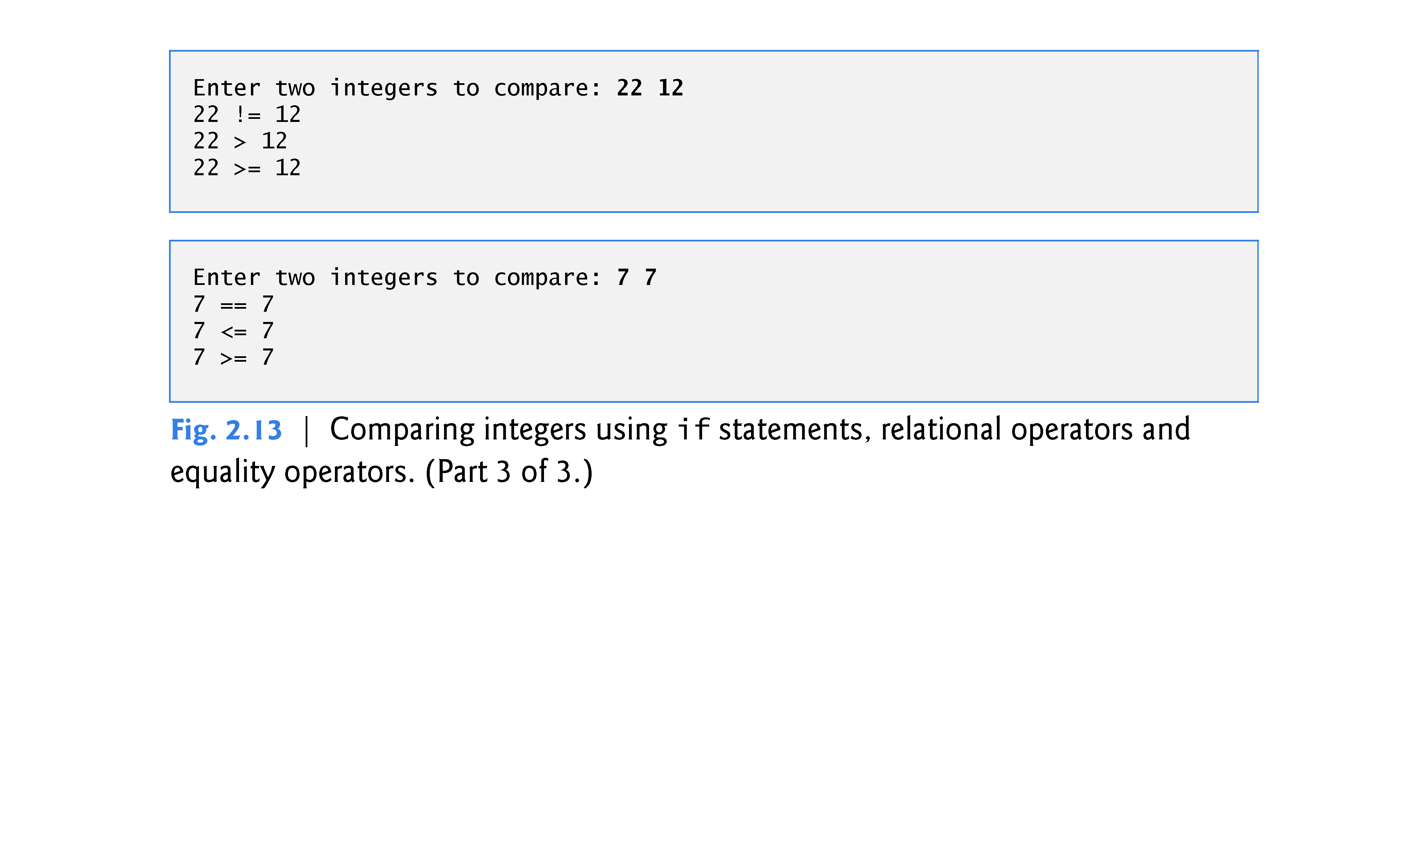

Slide 125
2.7 Decision Making: Equality and Relational Operators (cont.)
using declarations that eliminate the need to repeat the std:: prefix as we did in earlier programs.
Once we insert these using declarations, we can write cout instead of std::cout, cin instead of std::cin and endl instead of std::endl, respectively, in the remainder of the program.
Many programmers prefer to use the declaration
using namespace std;
which enables a program to use all the names in any standard C++ header file (such as <iostream>) that a program might include.
From this point forward in the book, we’ll use the preceding declaration in our programs.

Slide 126
2.7 Decision Making: Equality and Relational Operators (cont.)
Each if statement in Fig. 2.13 has a single statement in its body and each body statement is indented.
In Chapter 4 we show how to specify if statements with multiple-statement bodies (by enclosing the body statements in a pair of braces, { }, creating what’s called a compound statement or a block).

Slide 127
2.7 Decision Making: Equality and Relational Operators (cont.)
Statements may be split over several lines and may be spaced according to your prefer-ences.
It’s a syntax error to split identifiers, strings (such as "hello") and constants (such as the number 1000) over several lines.

Slide 128
2.7 Decision Making: Equality and Relational Operators (cont.)
Figure 2.14 shows the precedence and associativity of the operators introduced in this chapter.
The operators are shown top to bottom in decreasing order of precedence.
All these operators, with the exception of the assignment operator =, associate from left to right.

Slide 129
